Slide 1
Nusselt Number

Slide 2
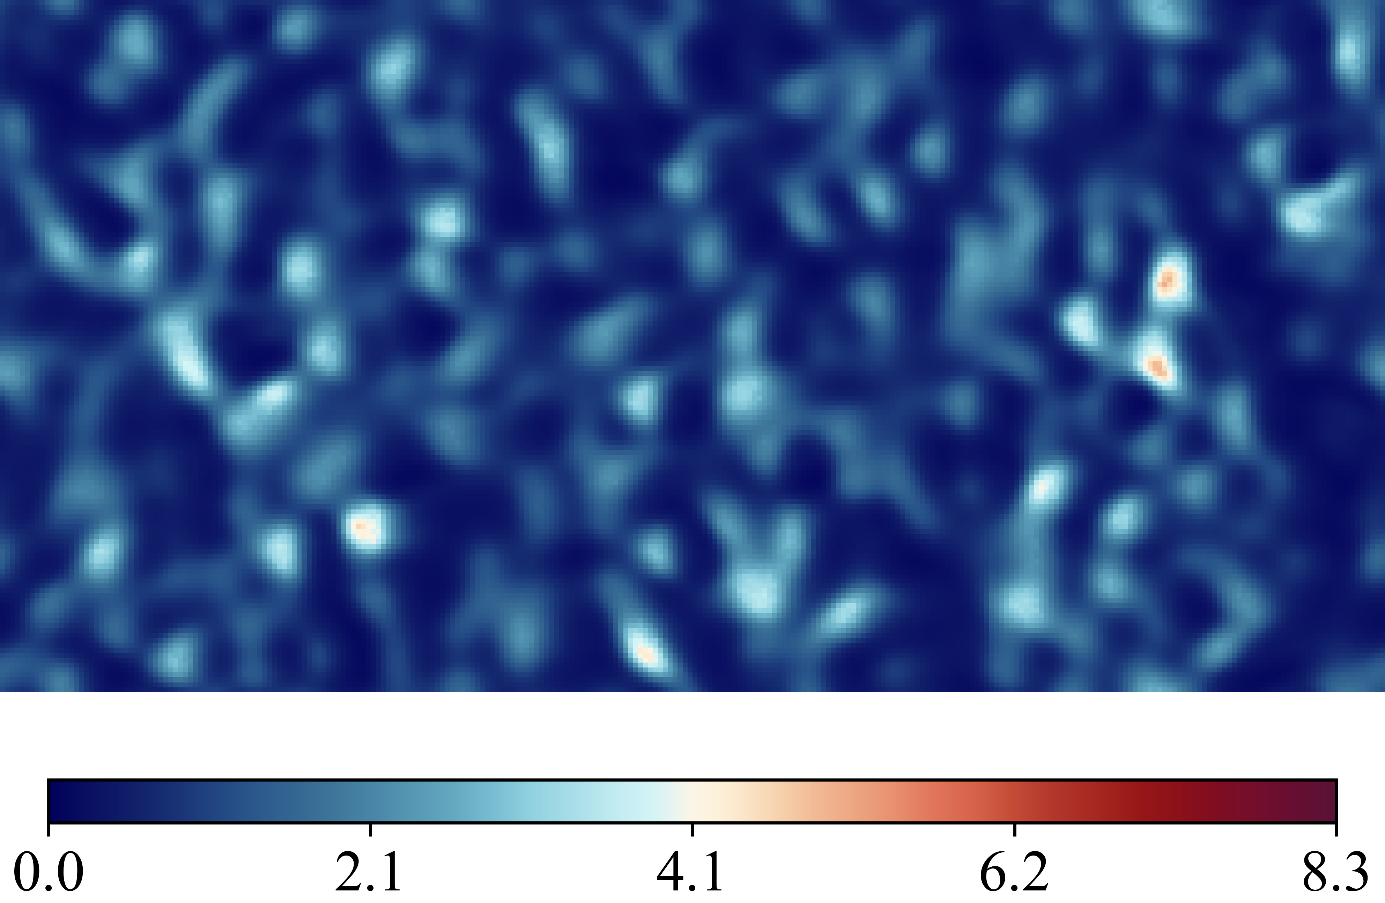
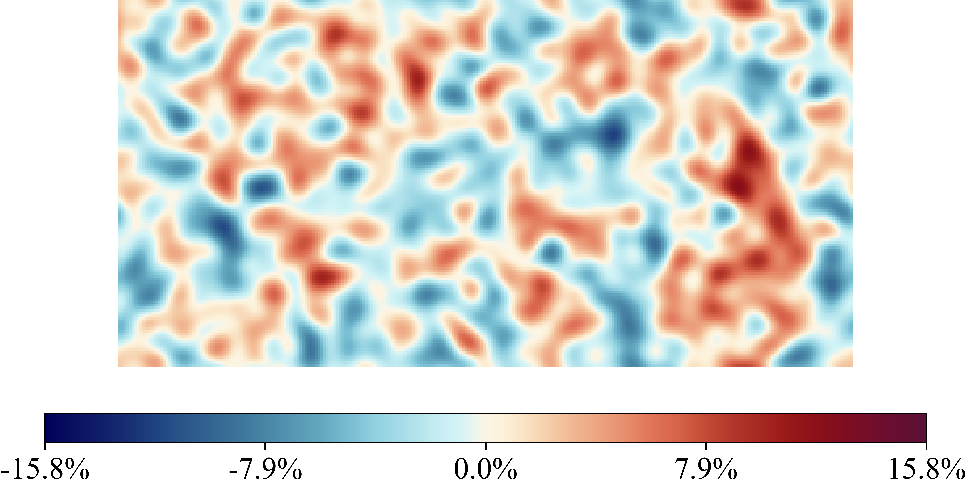
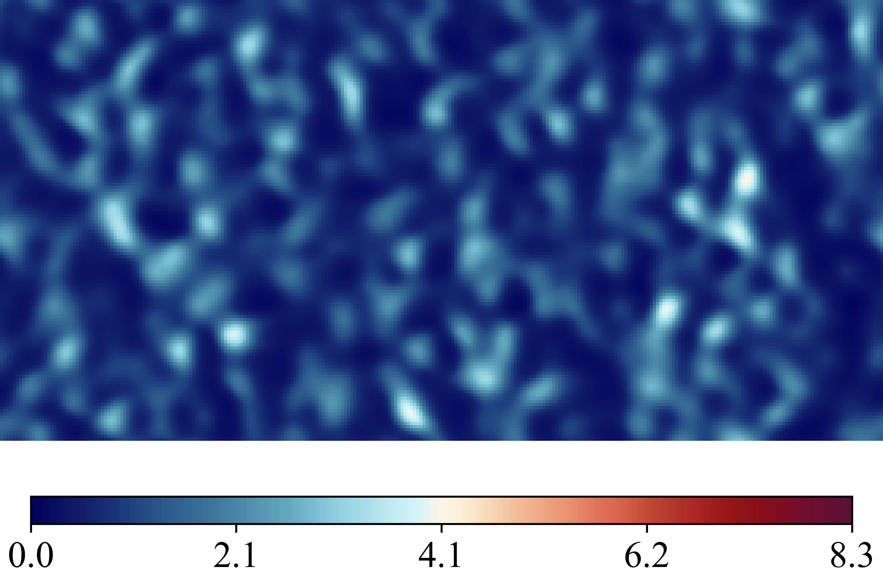
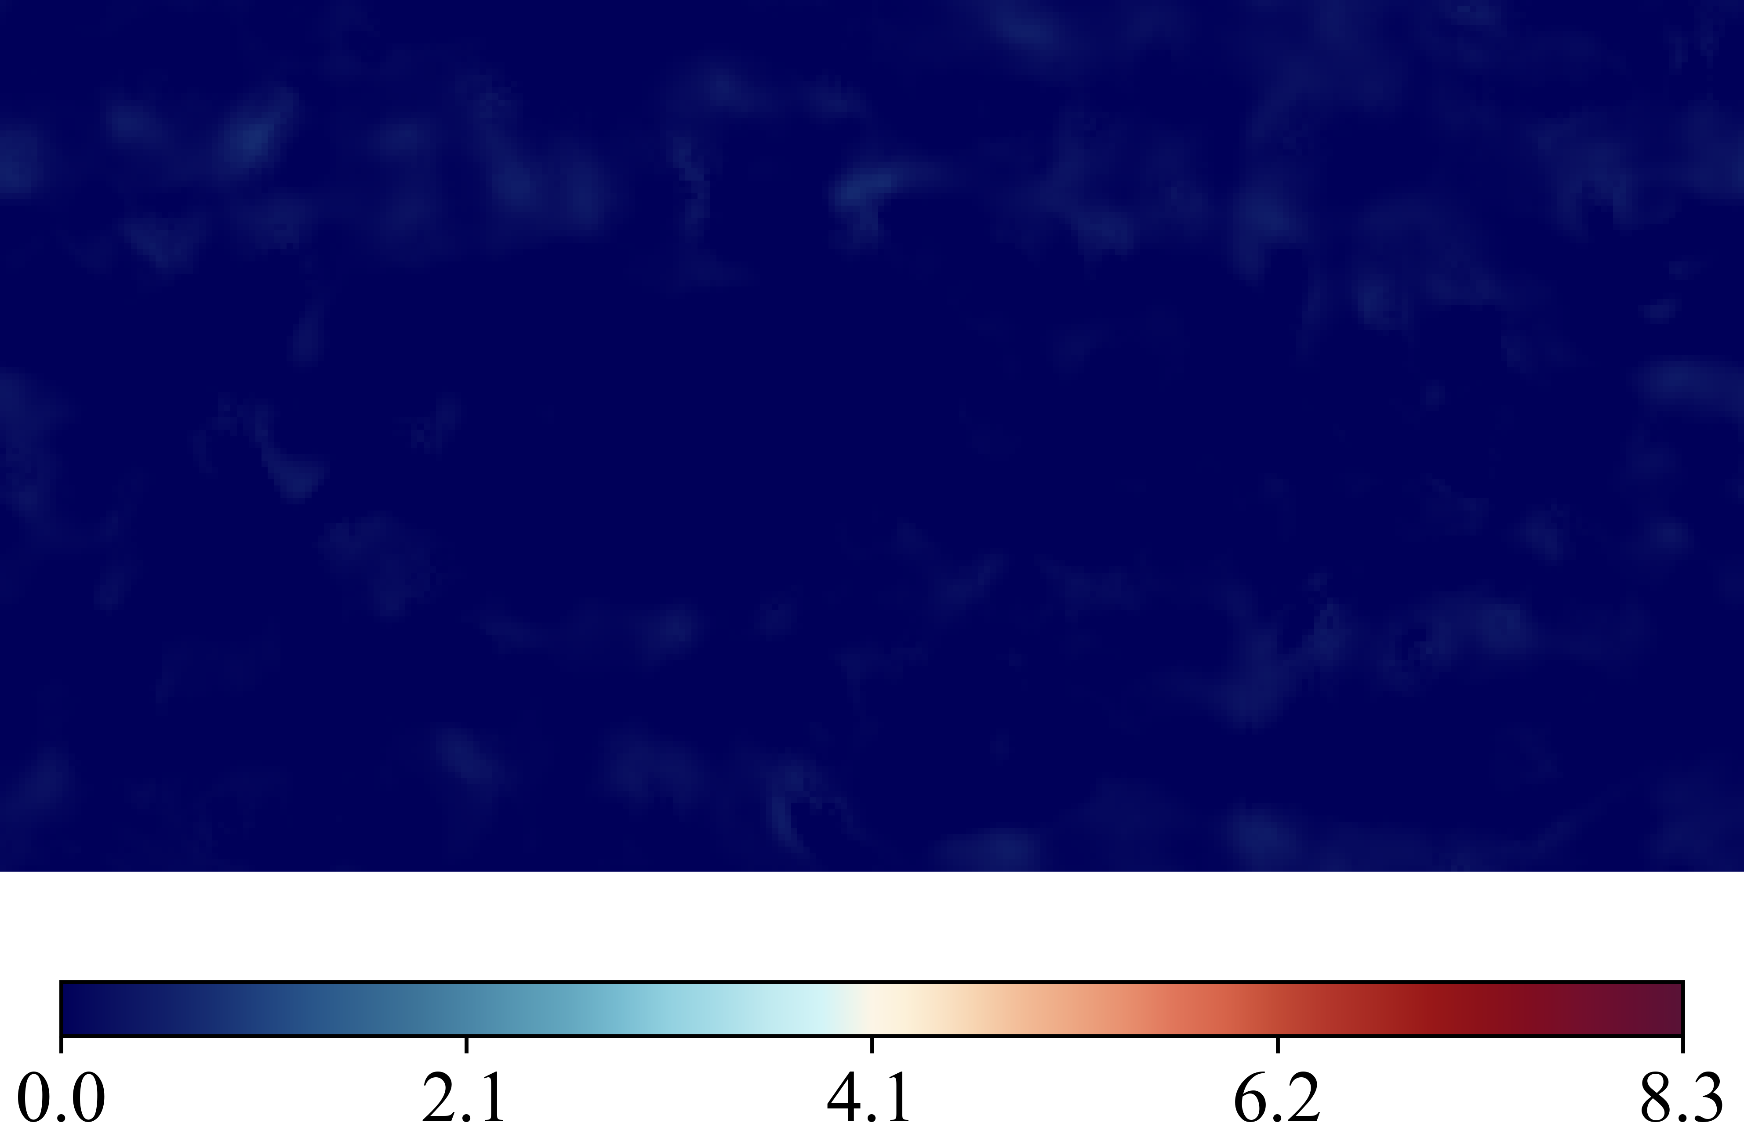
Case 20250516_102419_rnd12_K03_l1_Nu_classic_net_alt2_orig_dset_valid_ind_0_Ktrials_1_2
(Nusselt Number)
DNS Labels
Height Map
Predicted (ML)
Errors Difference

Slide 3
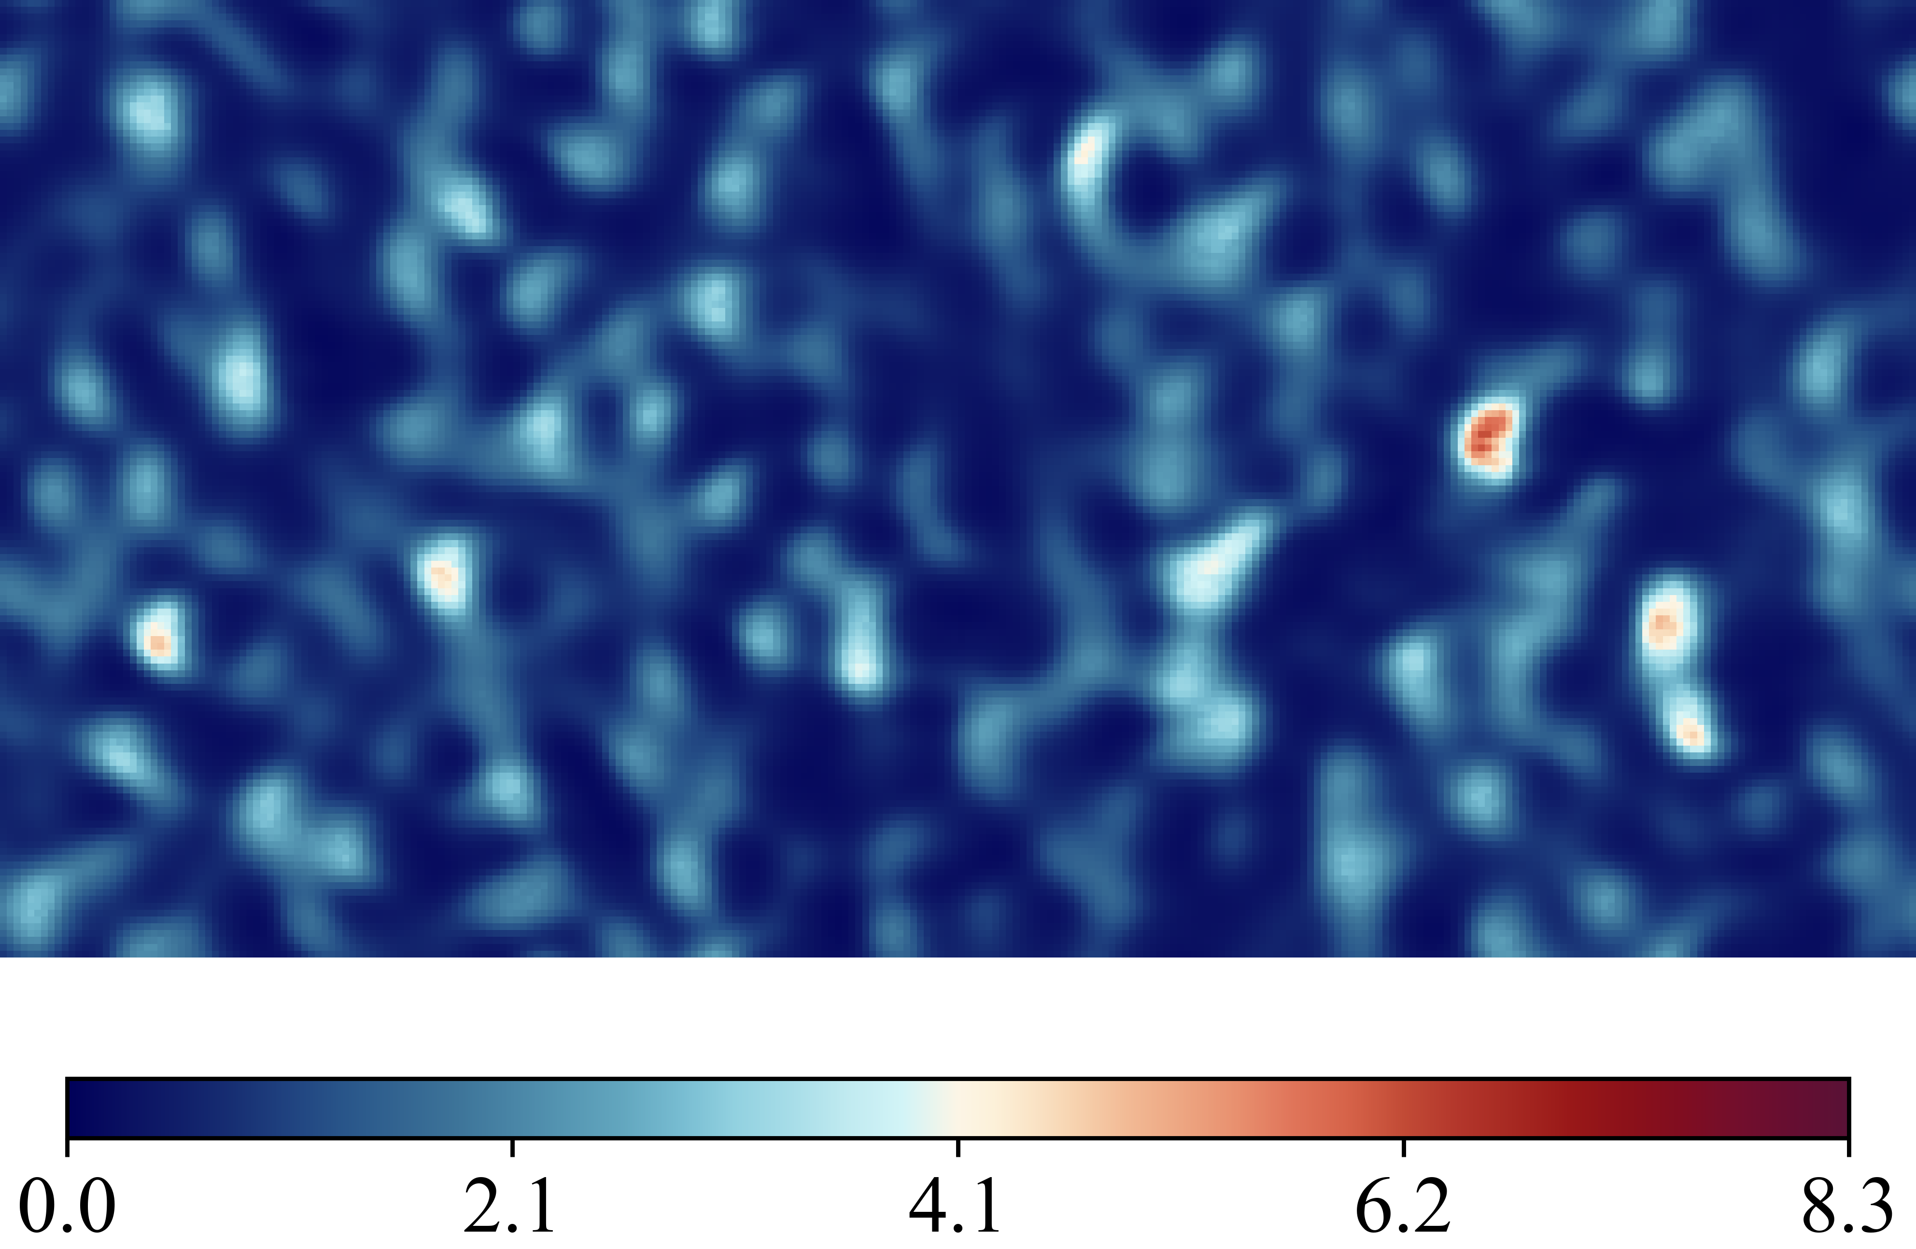
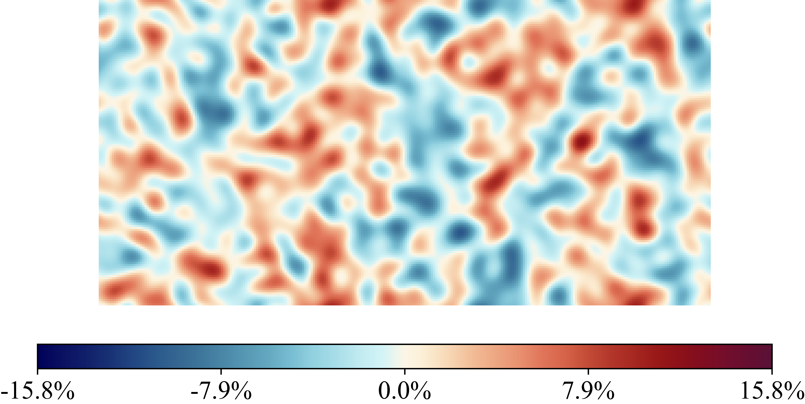
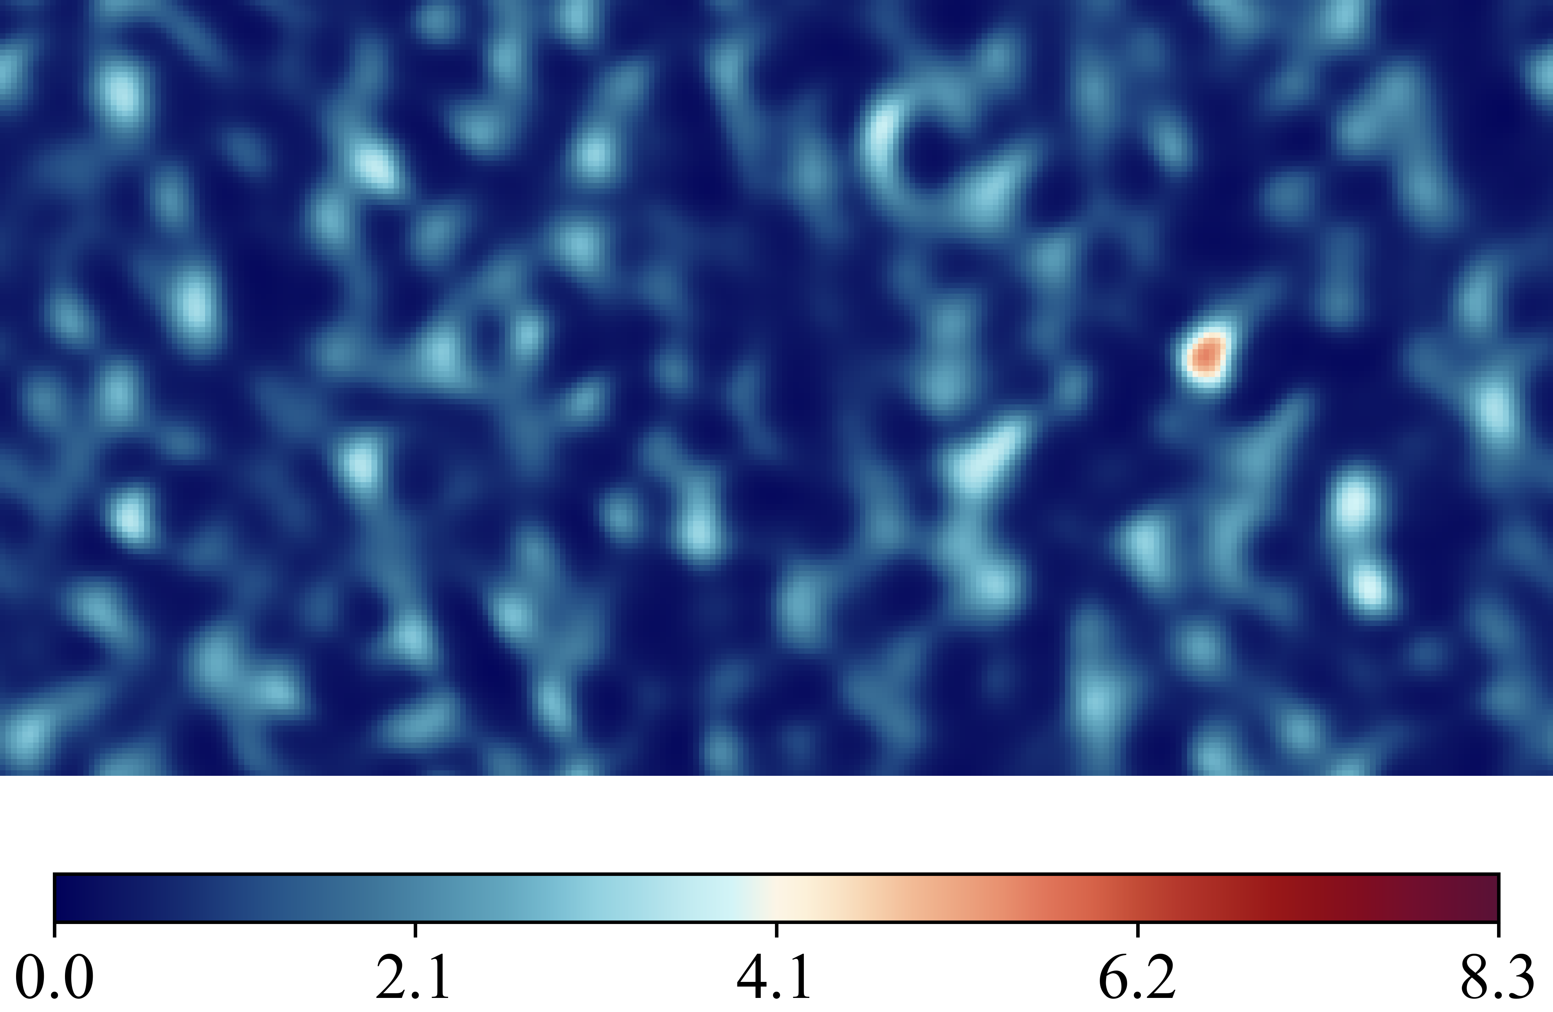
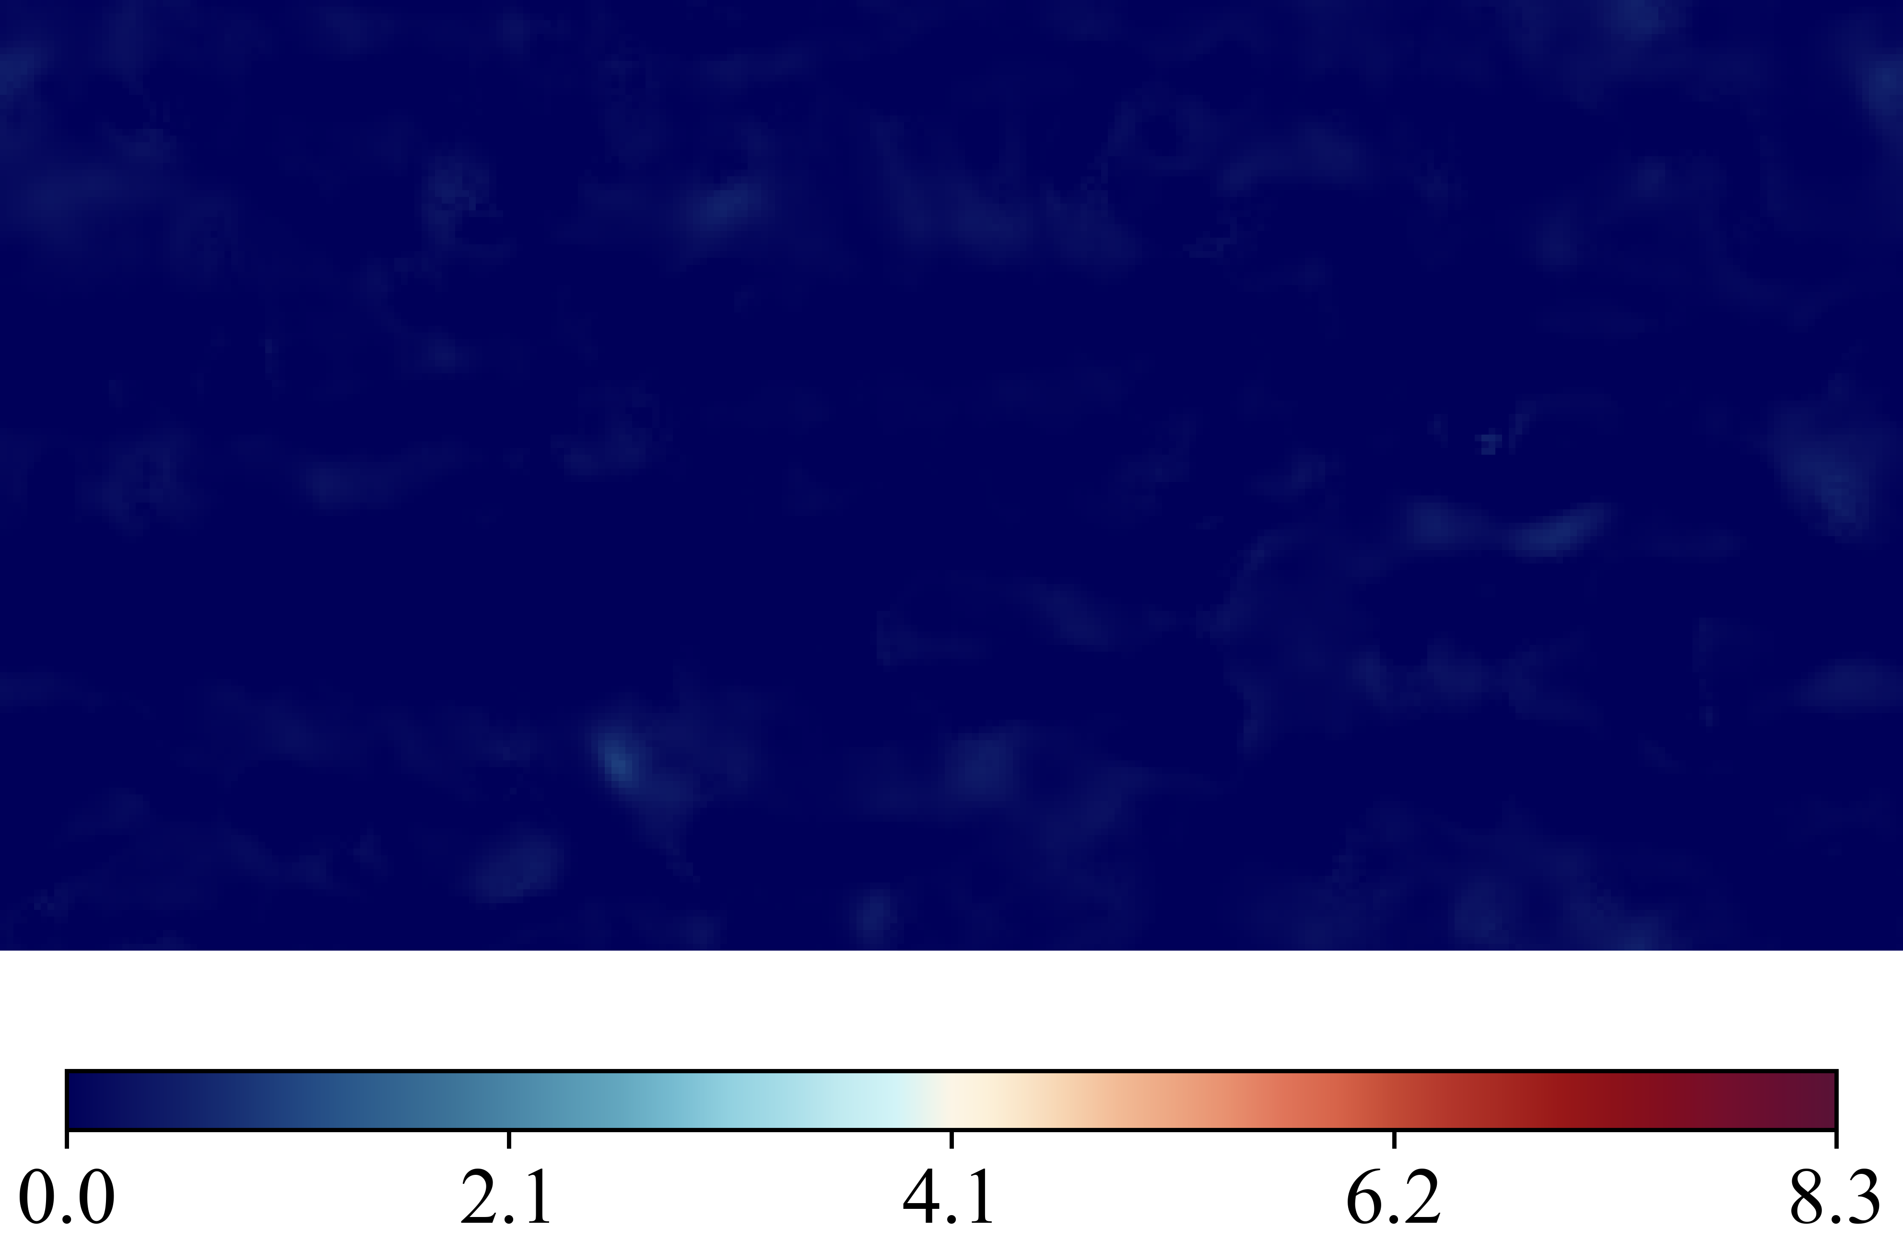
Case 20250516_102534_rnd12_K03_l1_Nu_classic_net_alt2_orig_dset_valid_ind_1_Ktrials_1_2
(Nusselt Number)
DNS Labels
Height Map
Predicted (ML)
Errors Difference

Slide 4
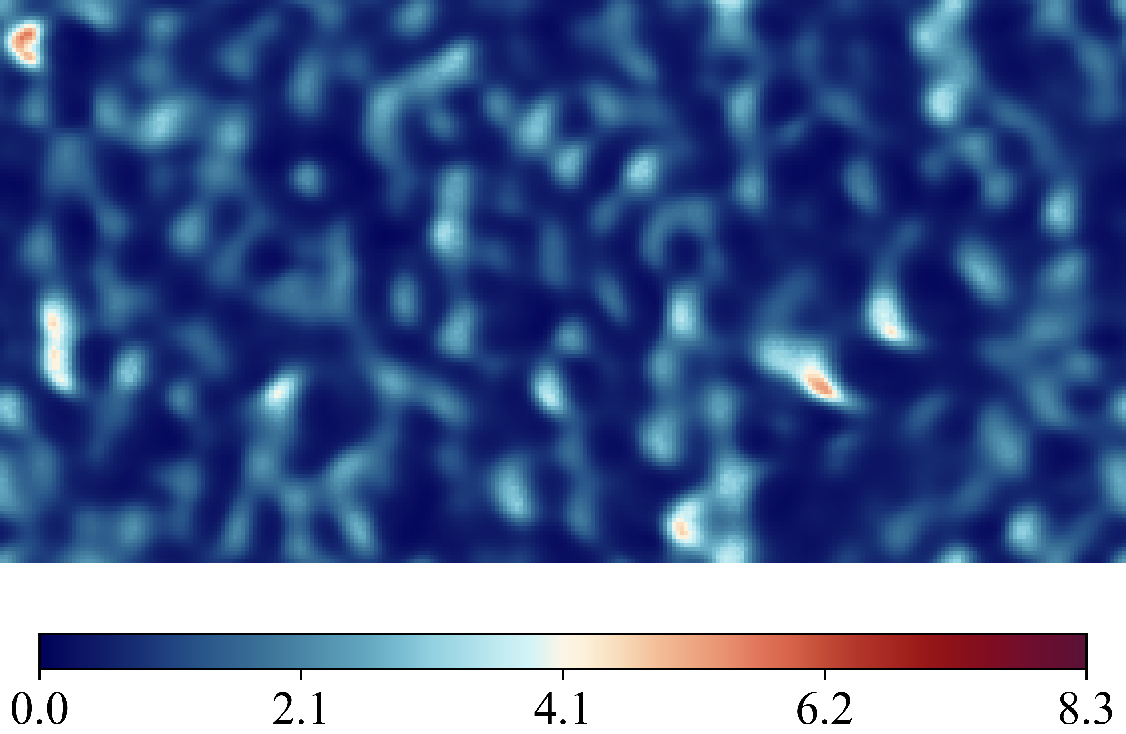
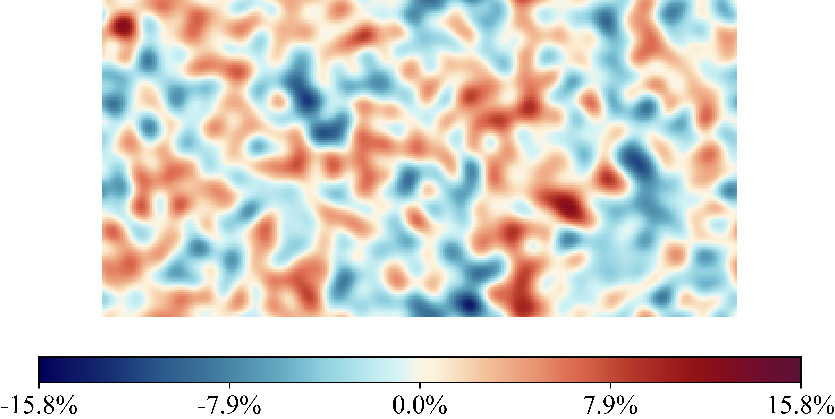

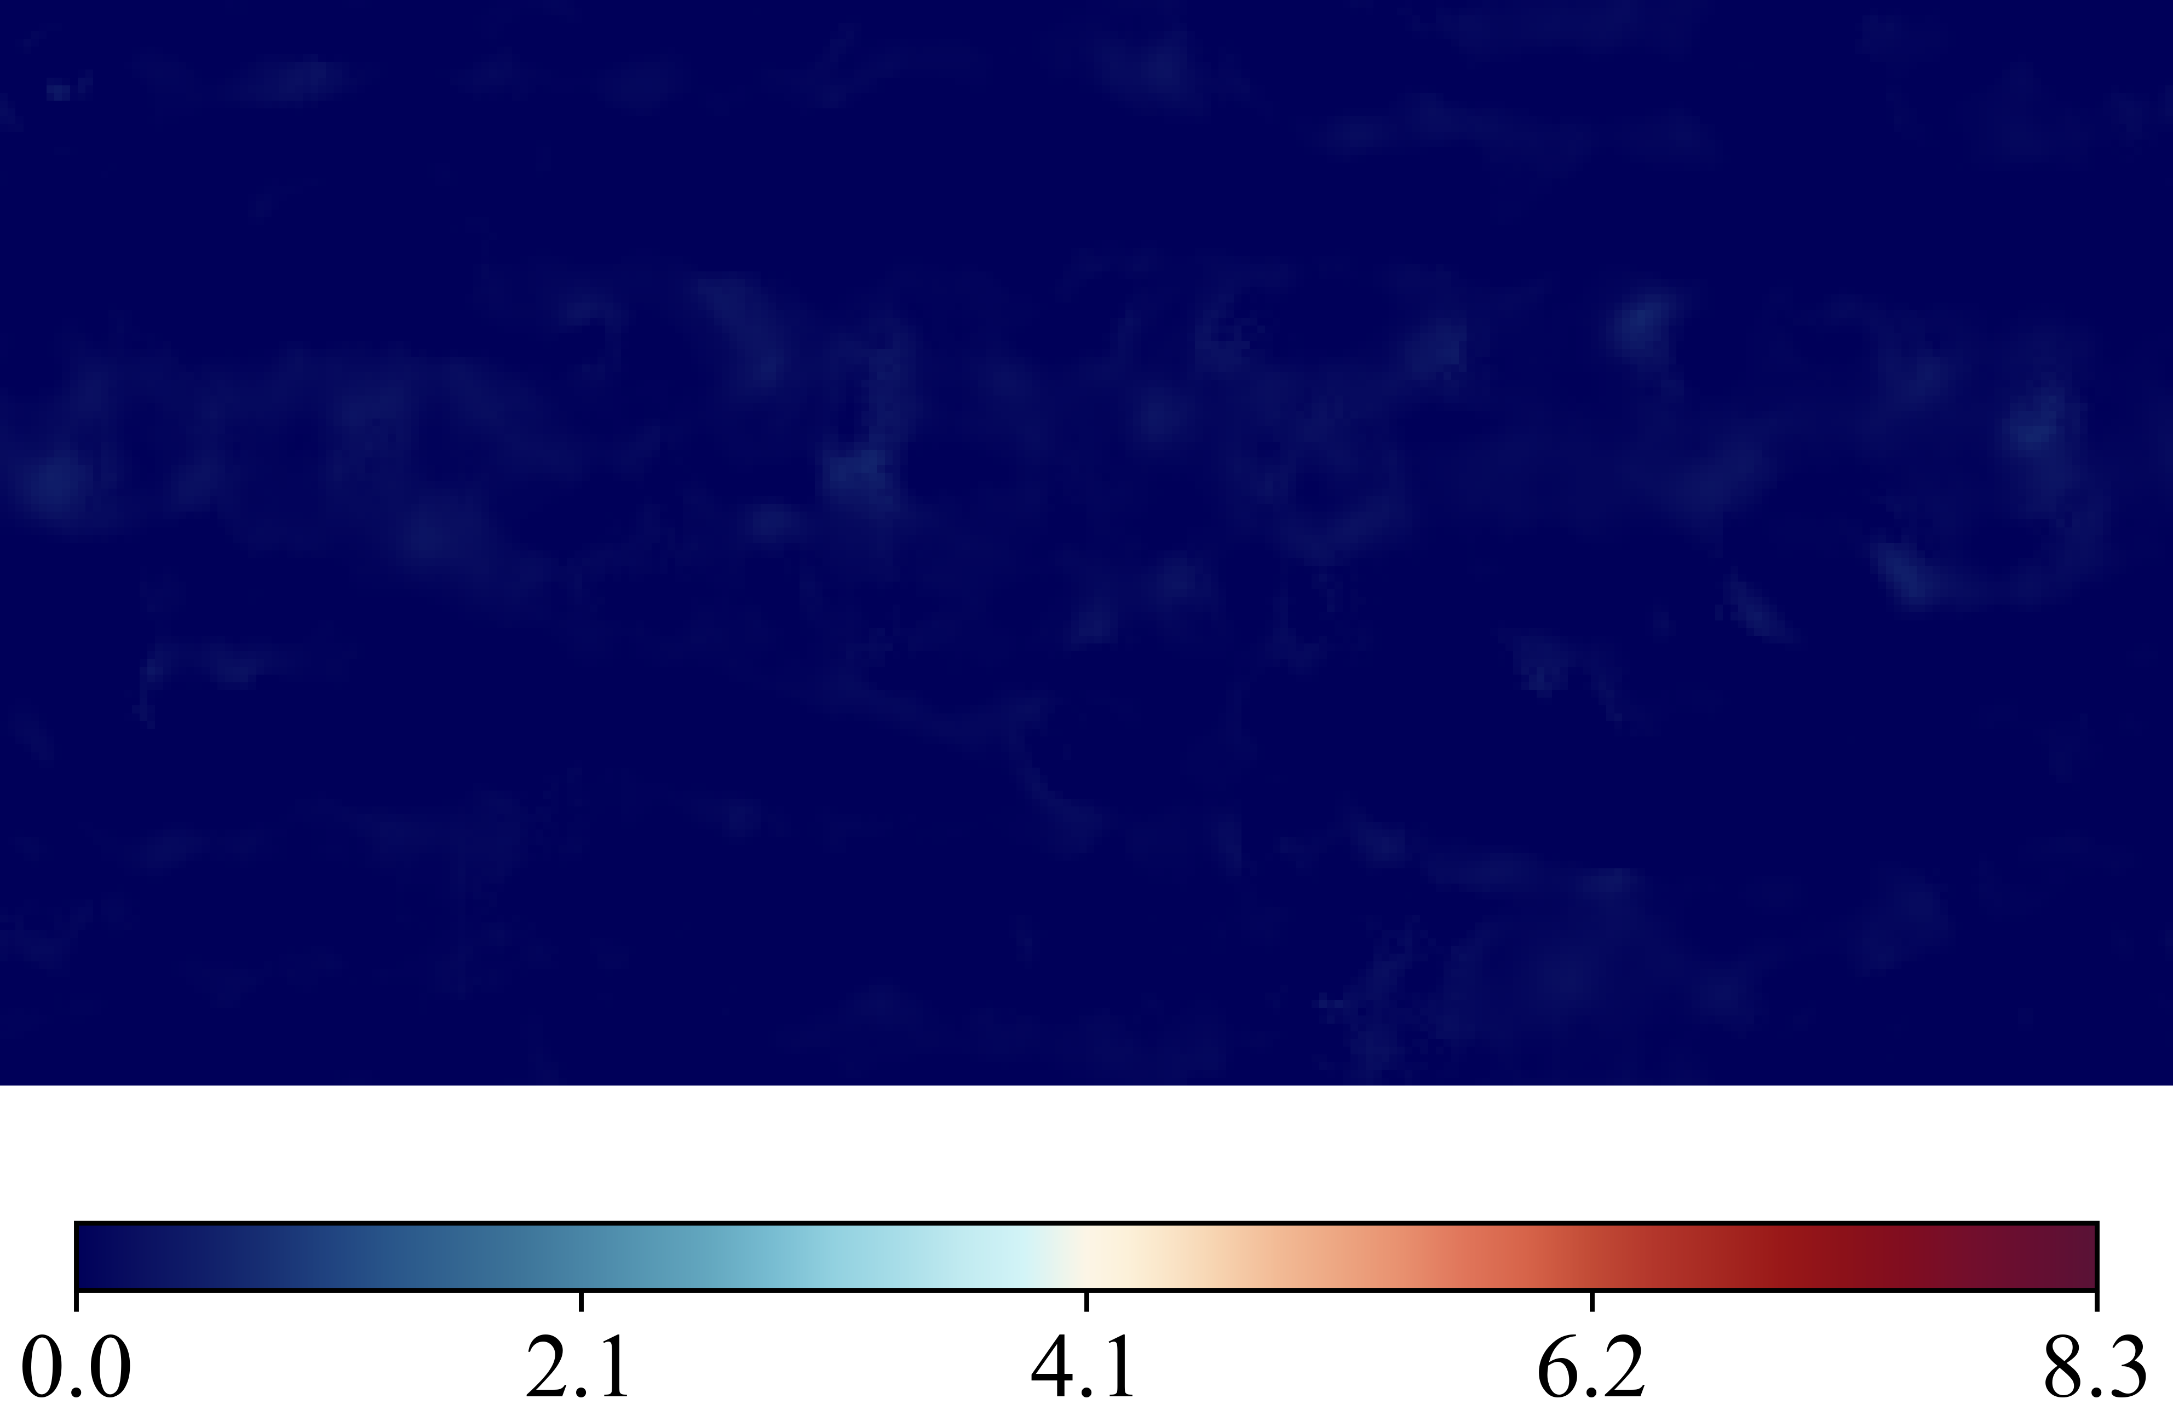
Case 20250516_102651_rnd12_K03_l1_Nu_classic_net_alt2_orig_dset_valid_ind_2_Ktrials_0_1
(Nusselt Number)
DNS Labels
Height Map
Predicted (ML)
Errors Difference

Slide 5
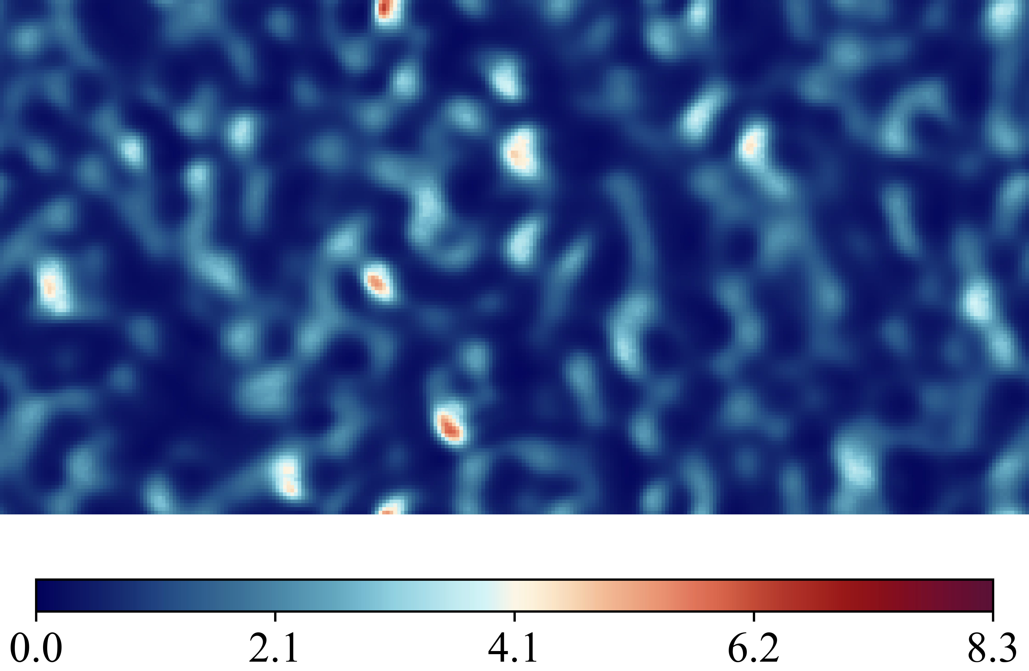
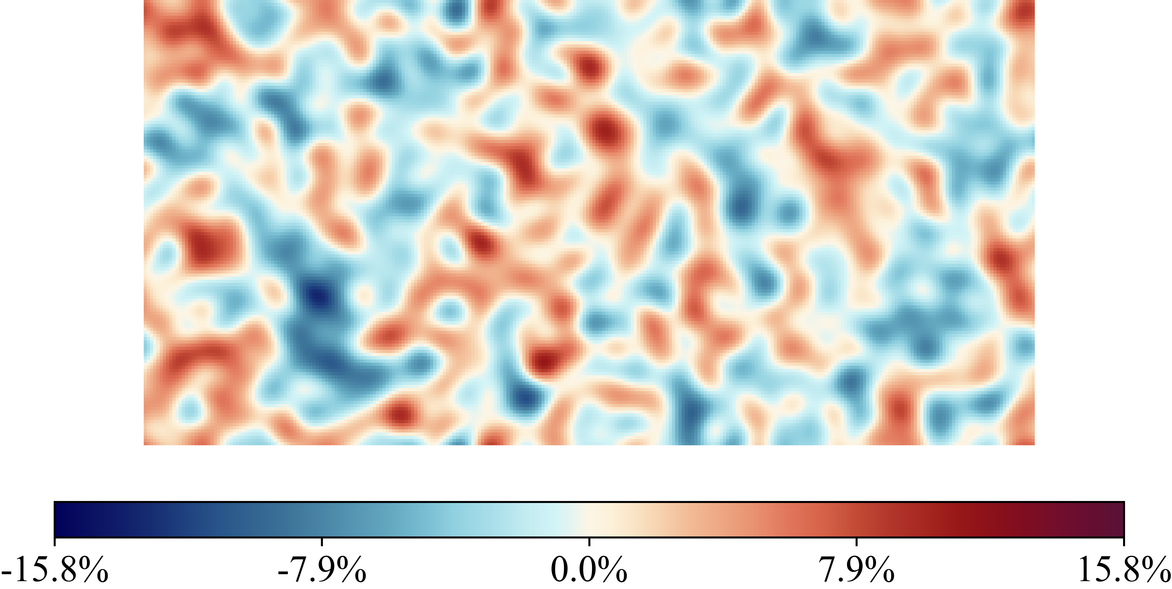
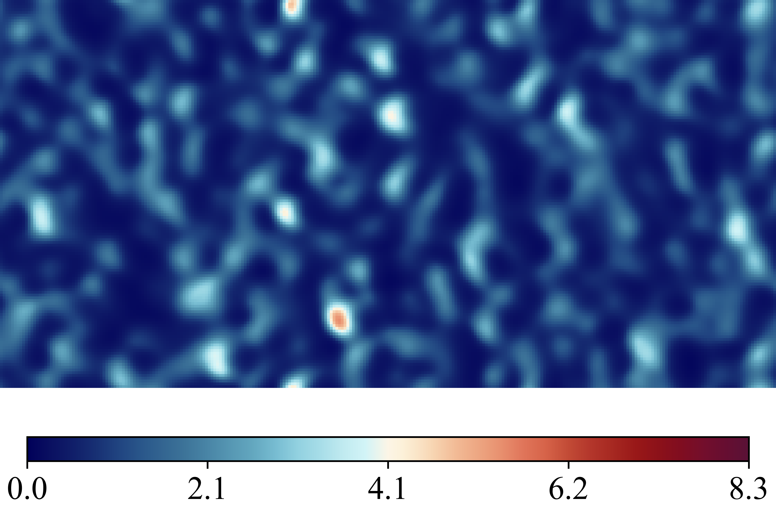
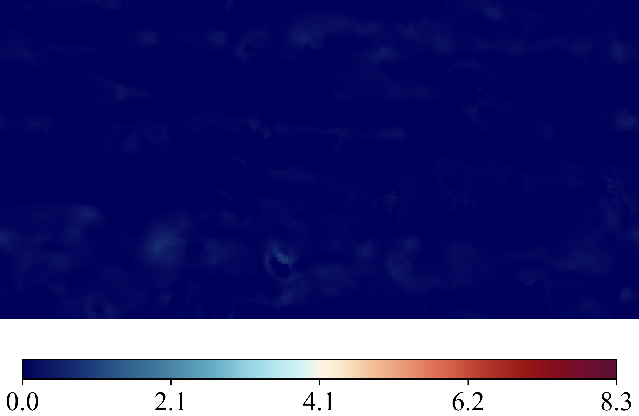
Case 20250516_102806_rnd12_K03_l1_Nu_classic_net_alt2_orig_dset_valid_ind_3_Ktrials_0_2
(Nusselt Number)
DNS Labels
Height Map
Predicted (ML)
Errors Difference

Slide 6
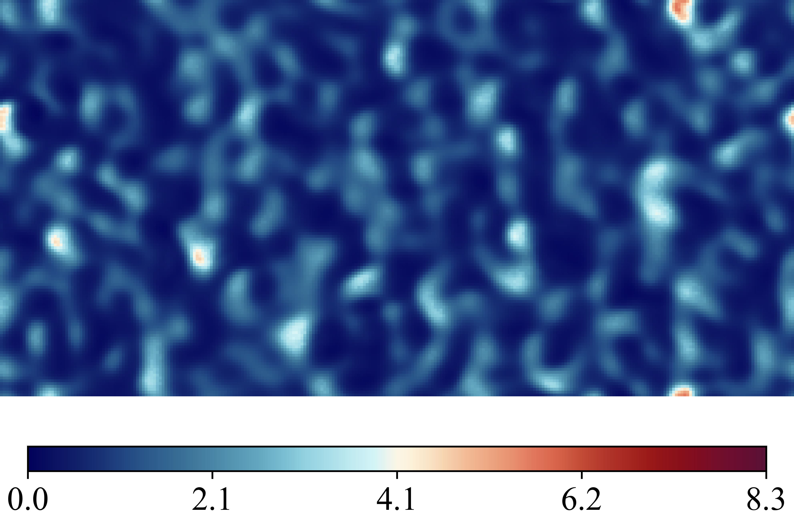
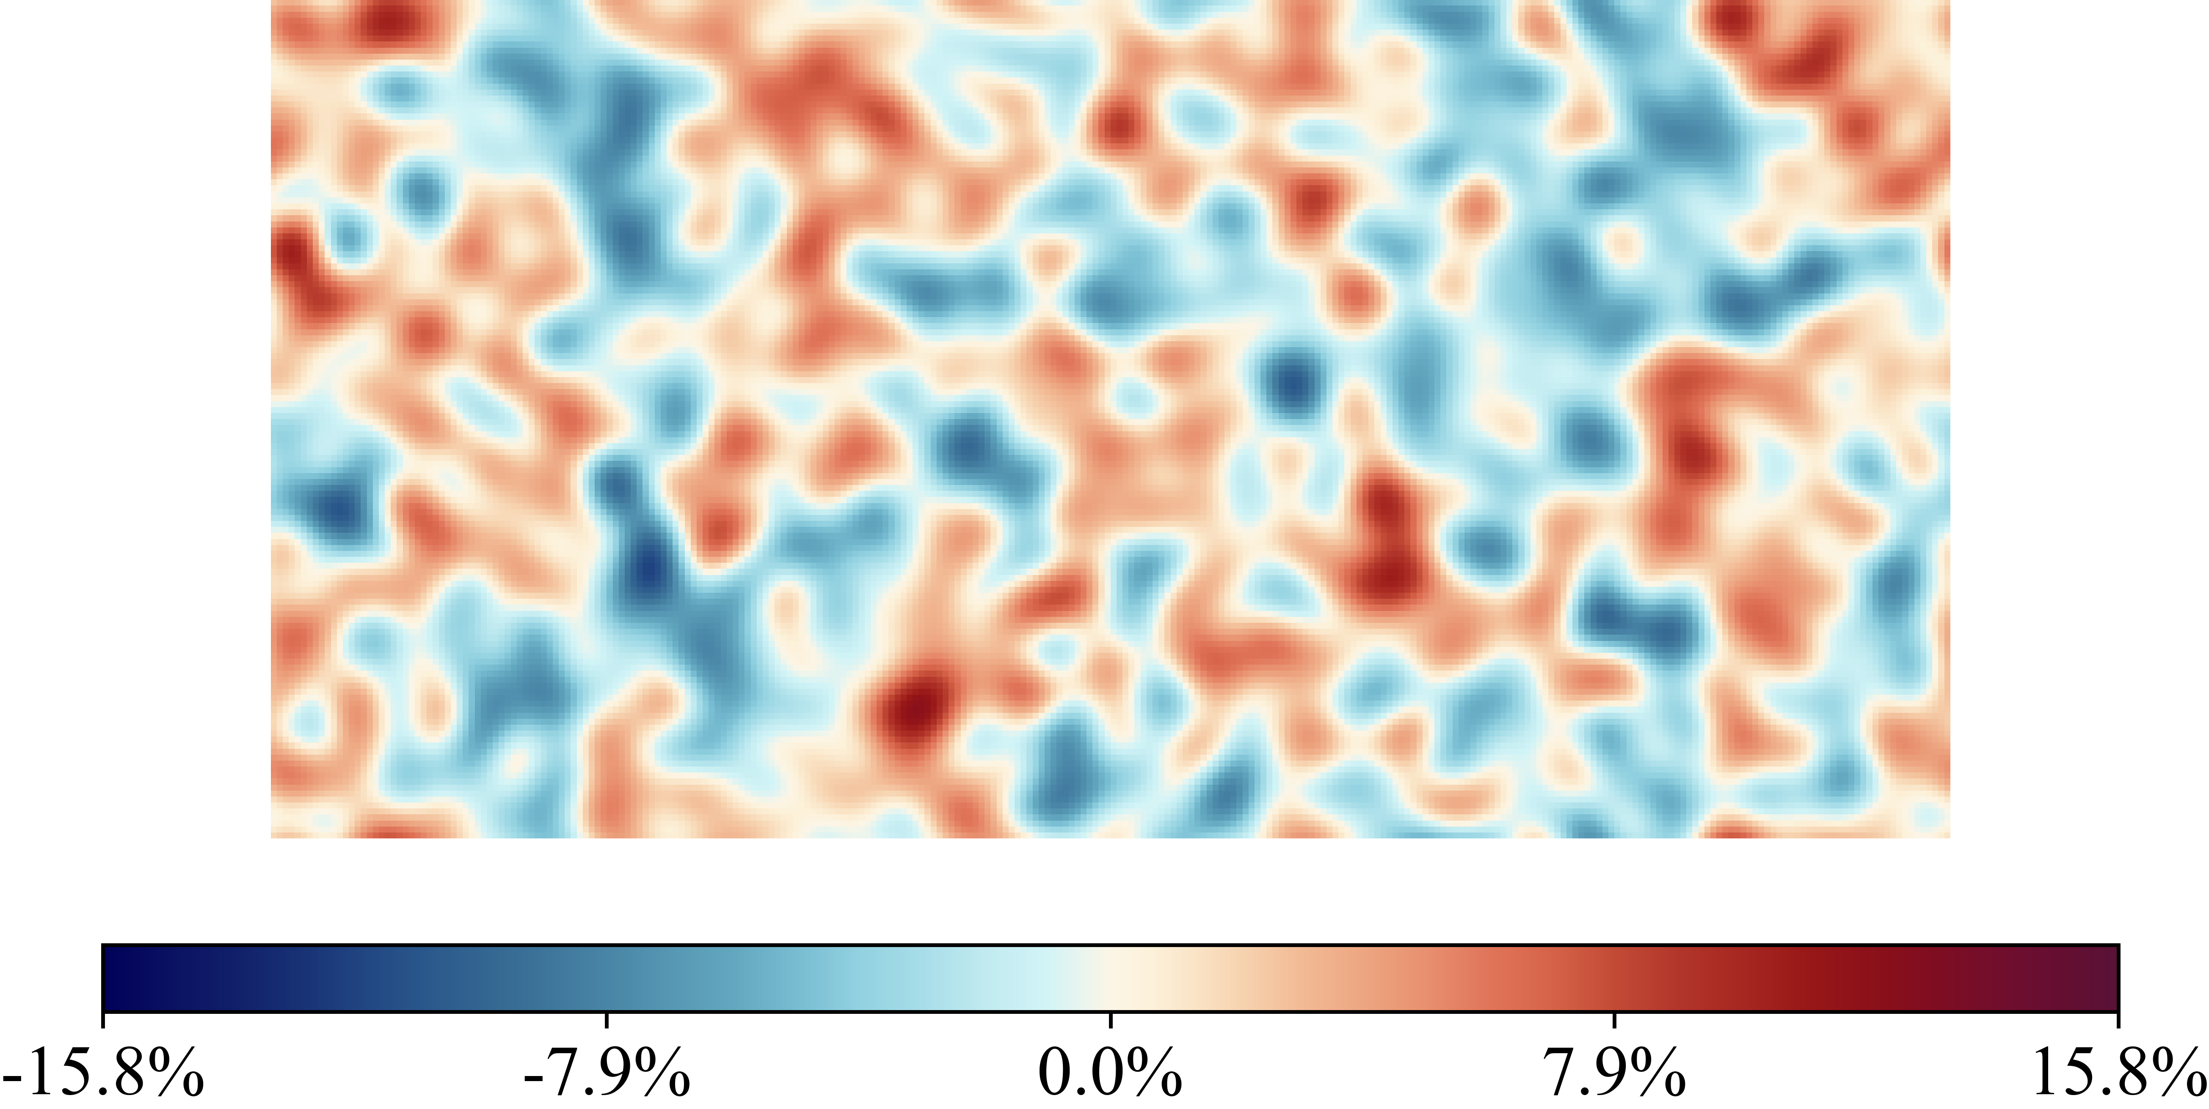
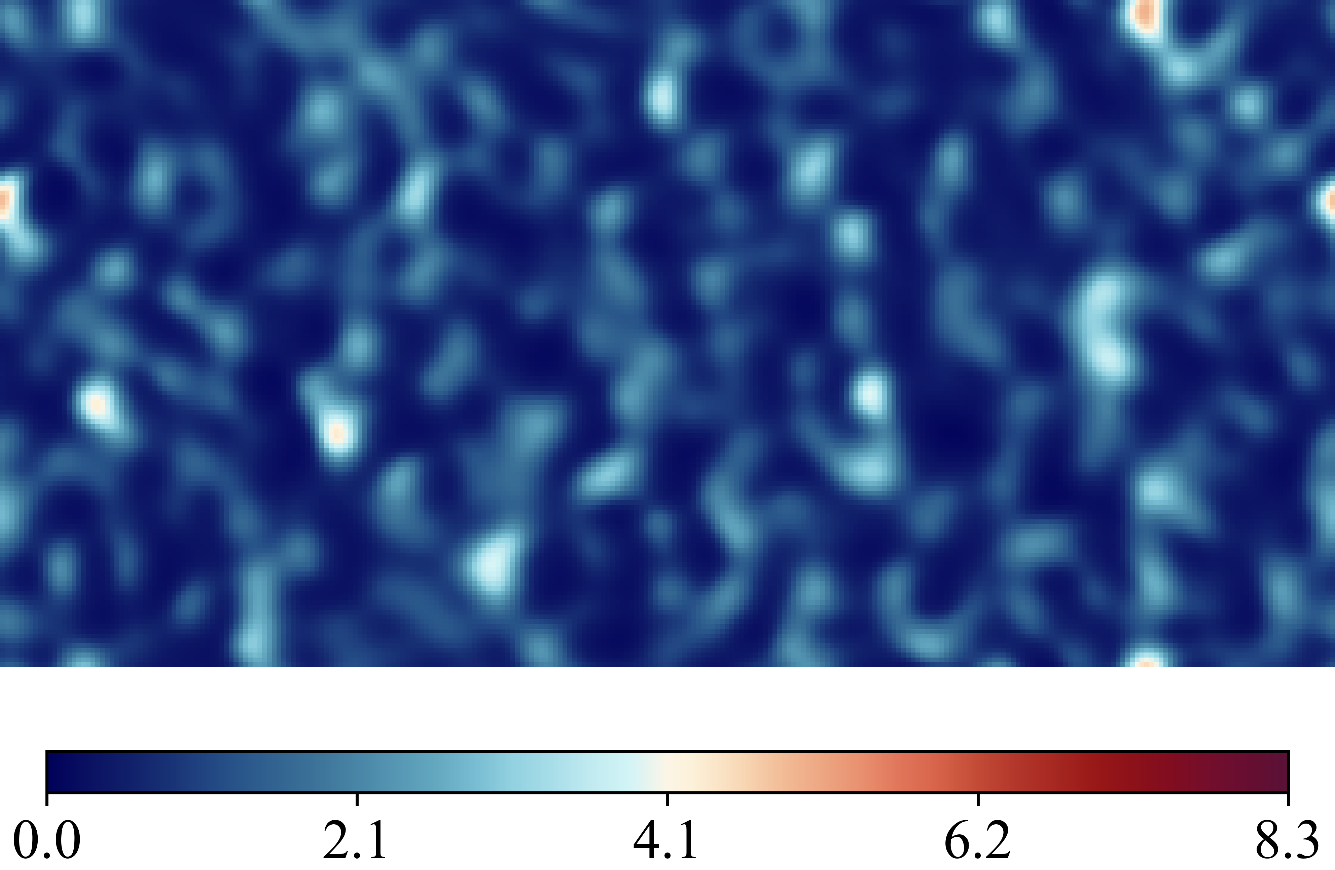
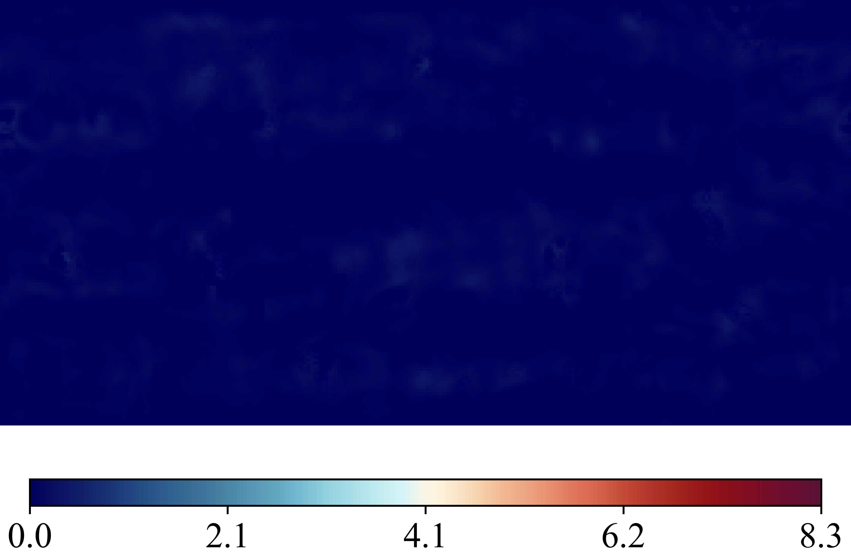
Case 20250516_102922_rnd12_K03_l1_Nu_classic_net_alt2_orig_dset_valid_ind_4_Ktrials_0_1
(Nusselt Number)
DNS Labels
Height Map
Predicted (ML)
Errors Difference

Slide 7
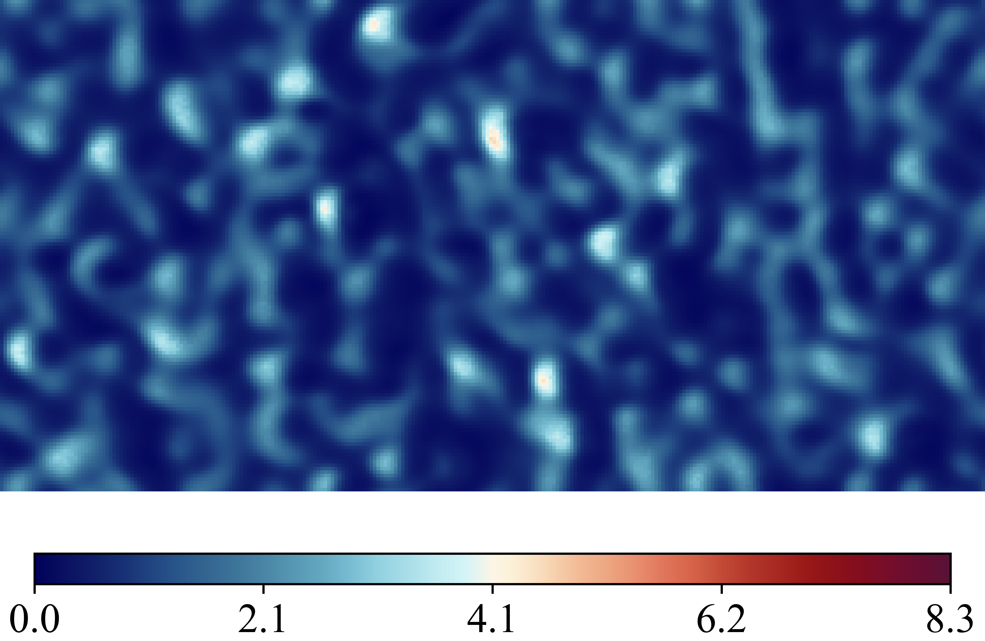
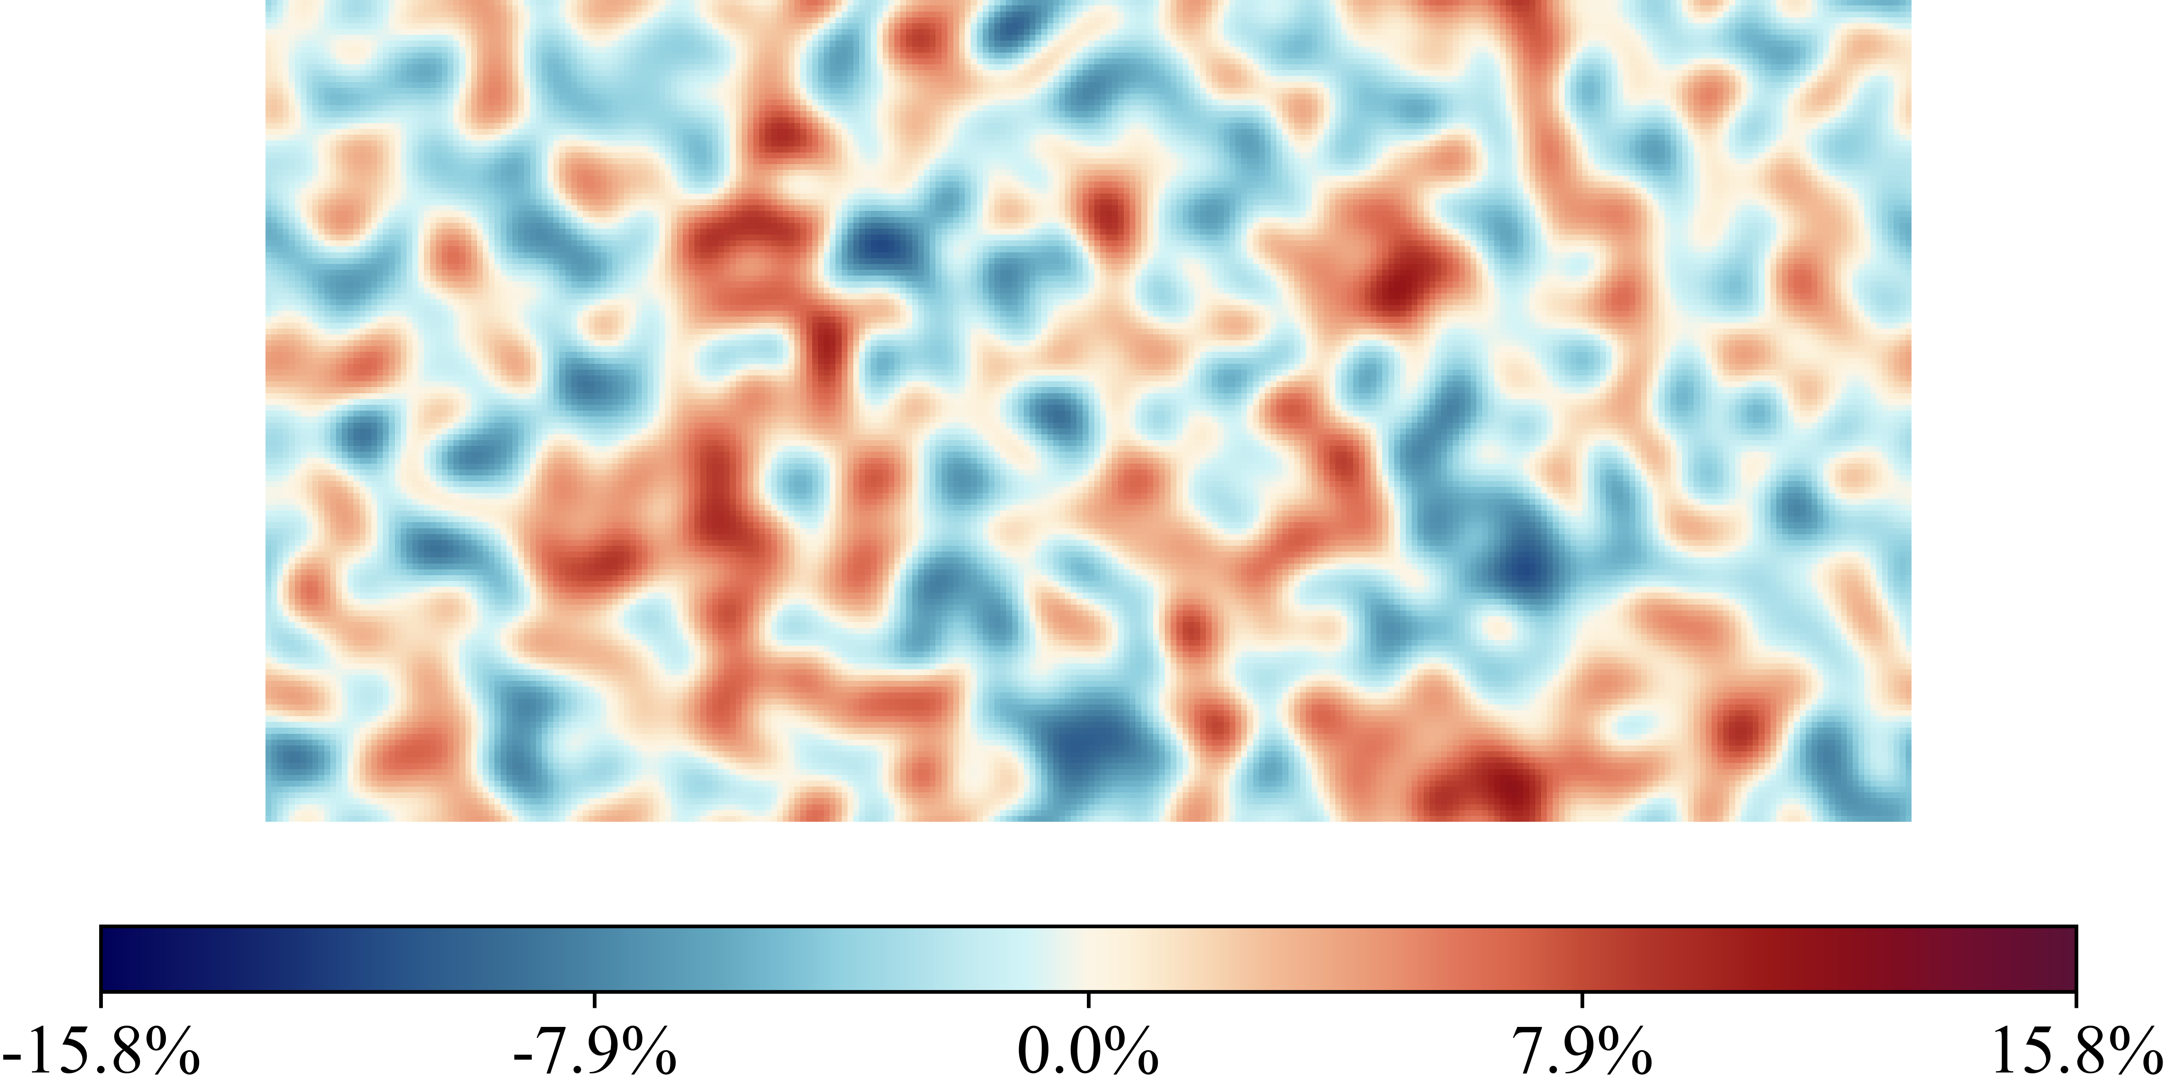
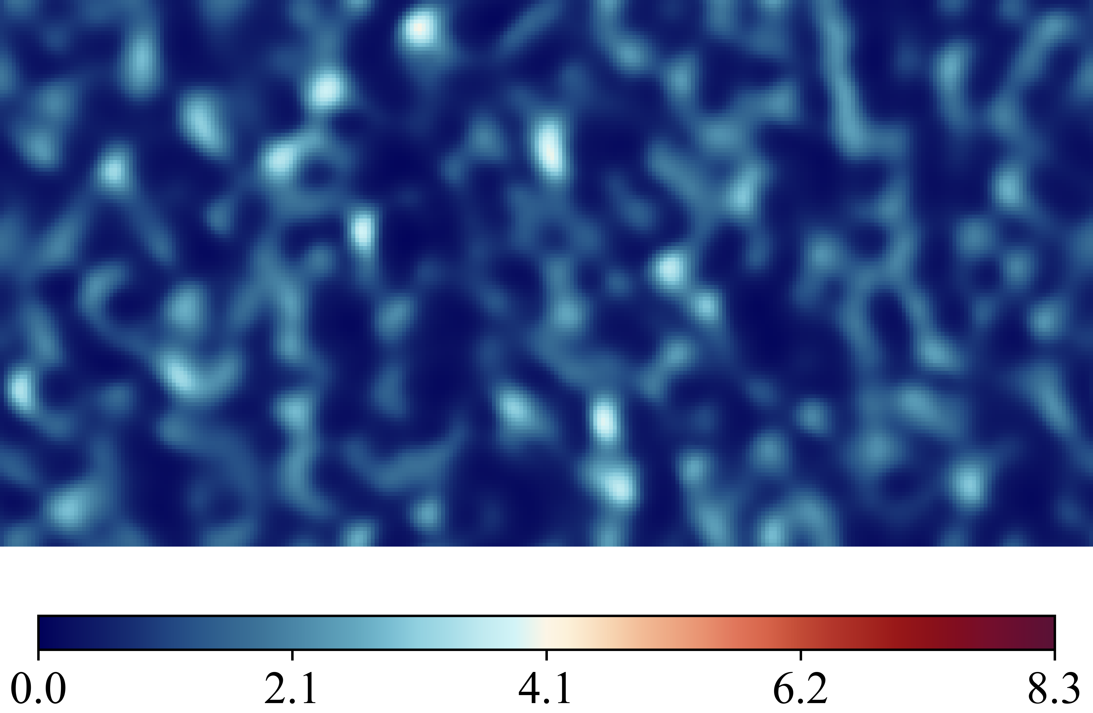
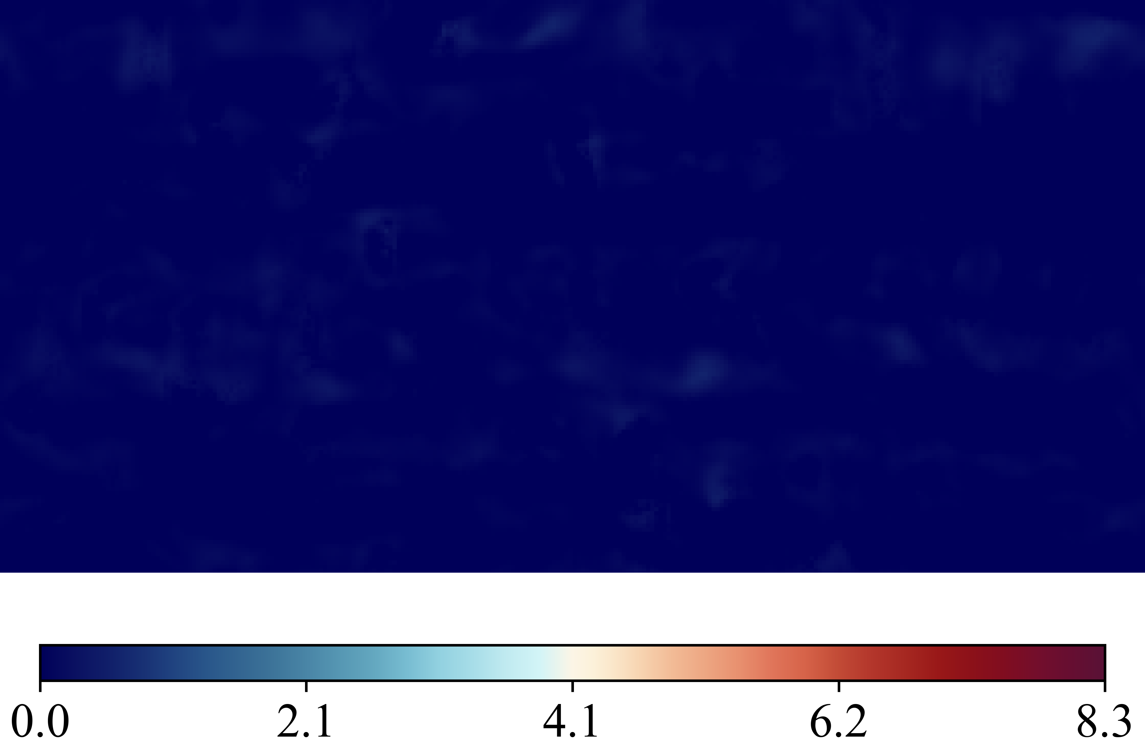
Case 20250516_103011_rnd12_K03_l1_Nu_classic_net_alt2_orig_dset_valid_ind_5_Ktrials_1_2
(Nusselt Number)
DNS Labels
Height Map
Predicted (ML)
Errors Difference

Slide 8
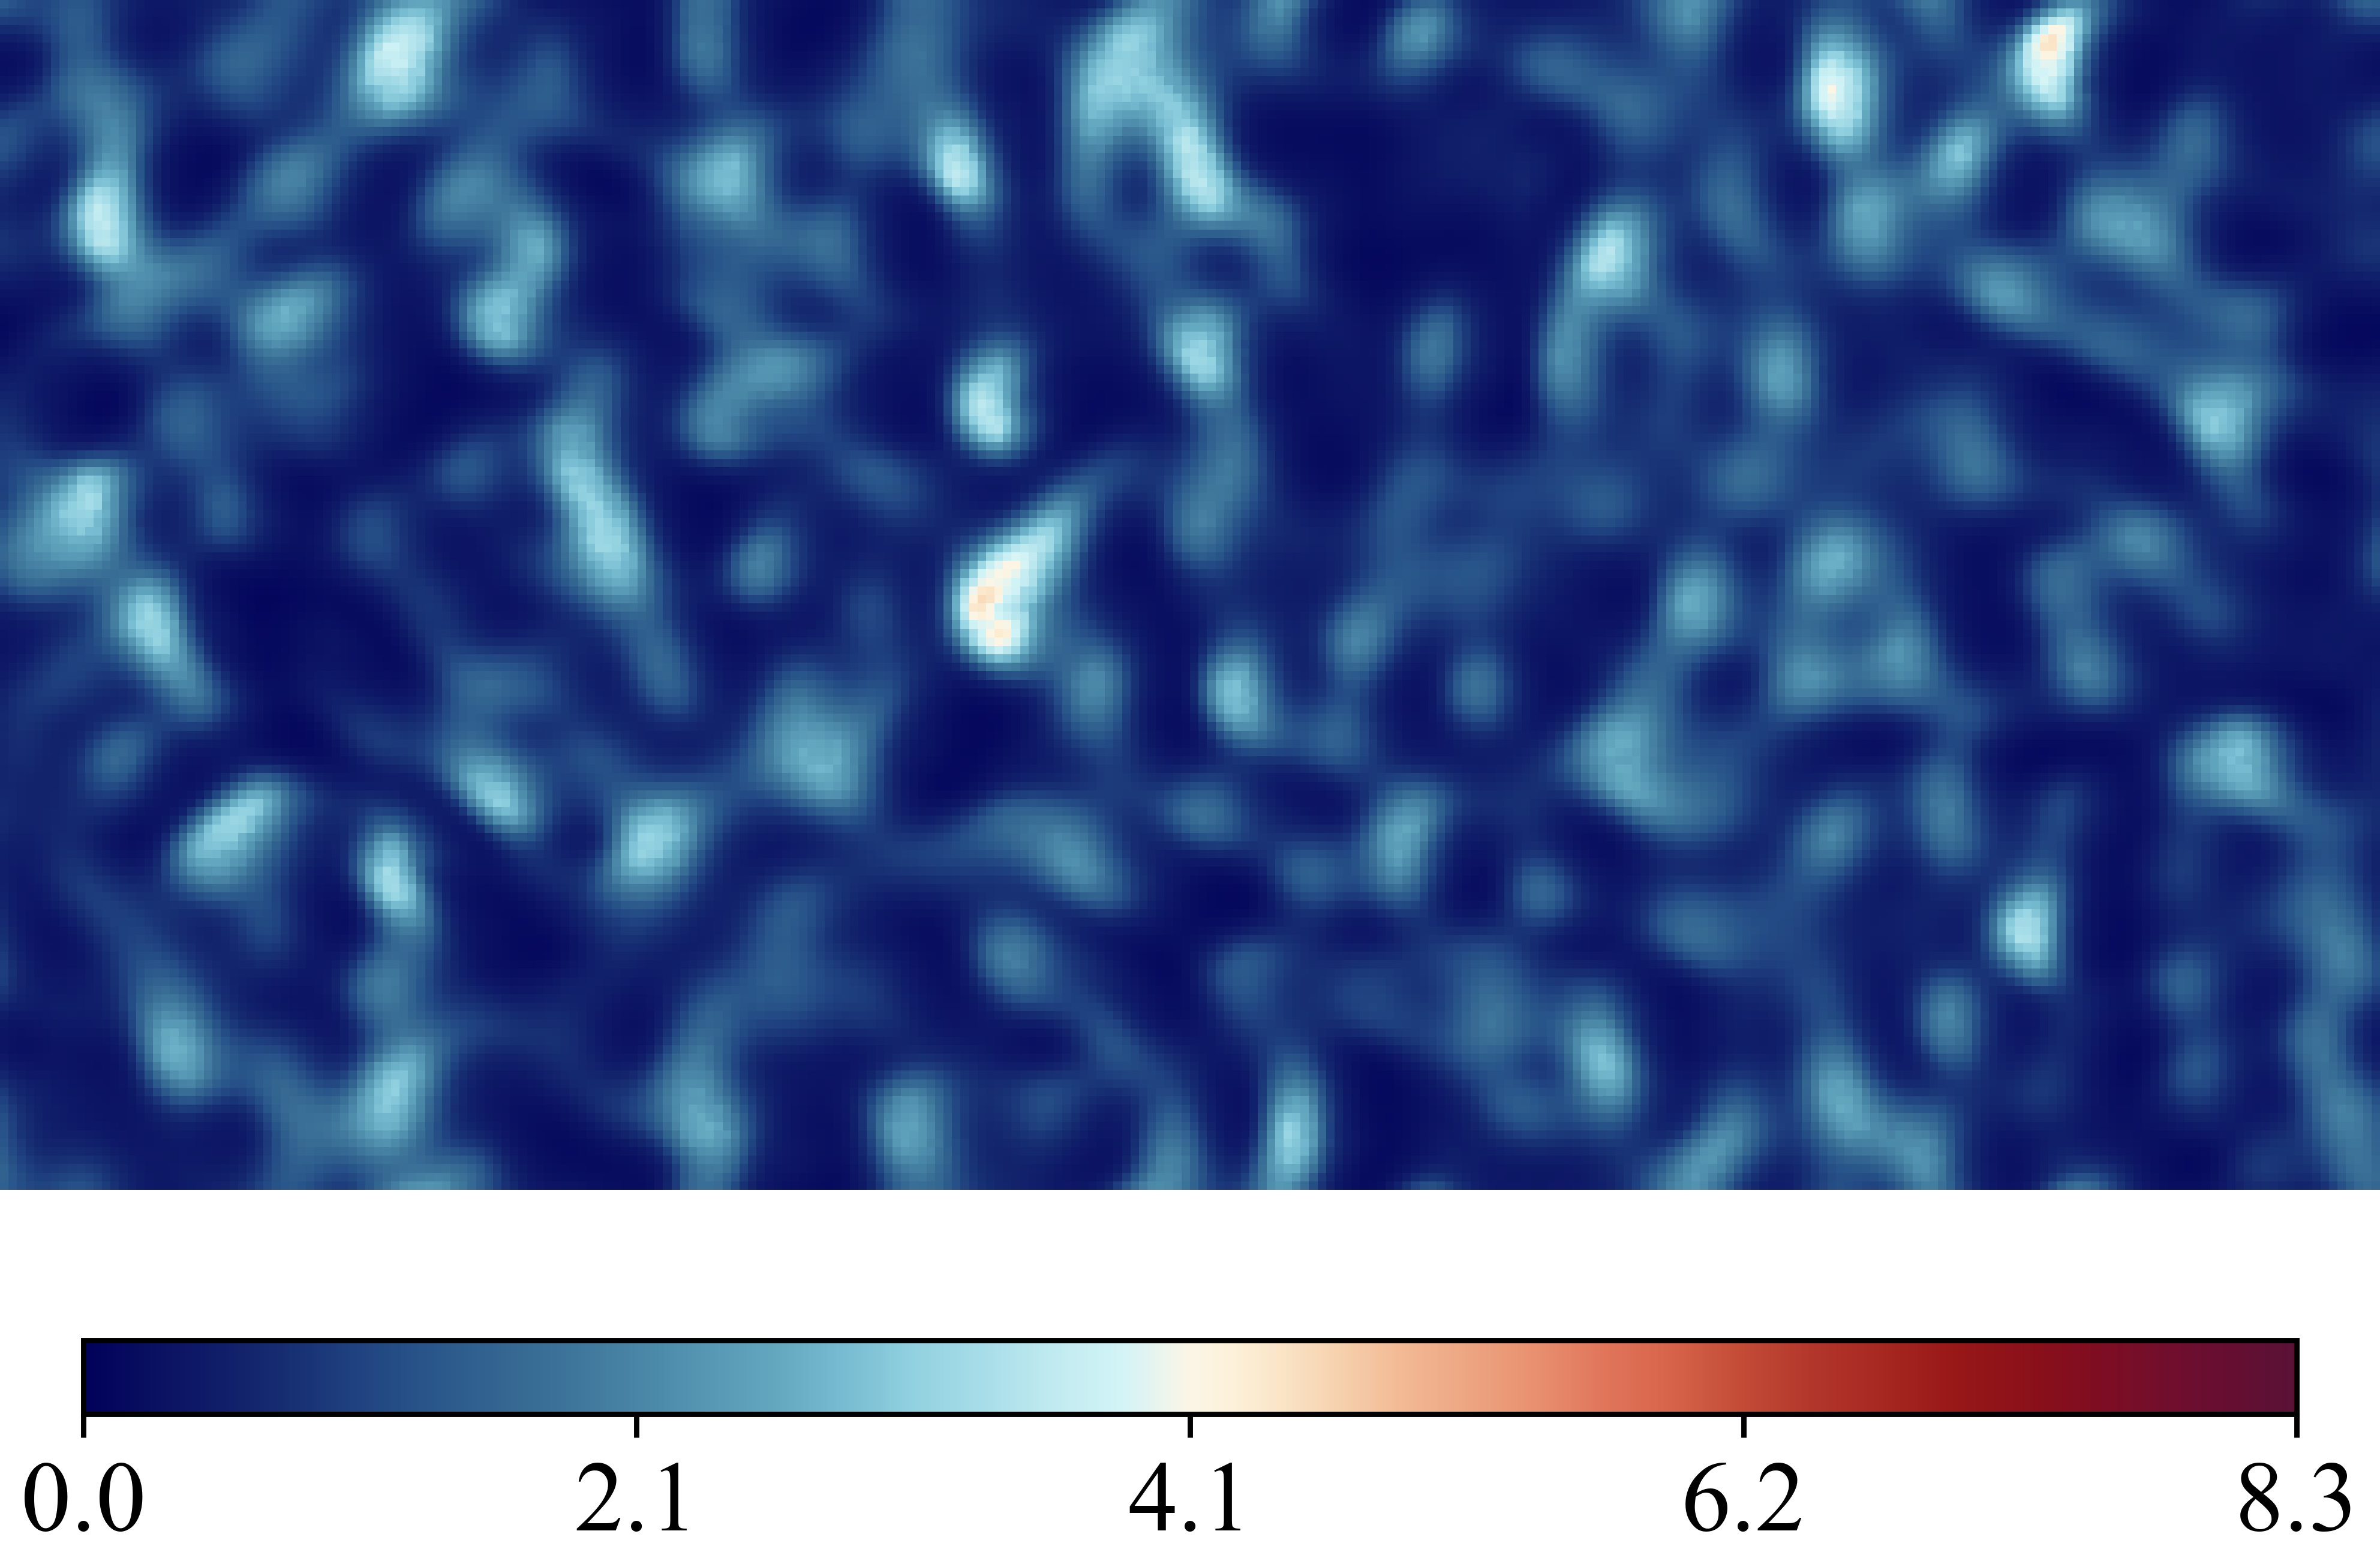
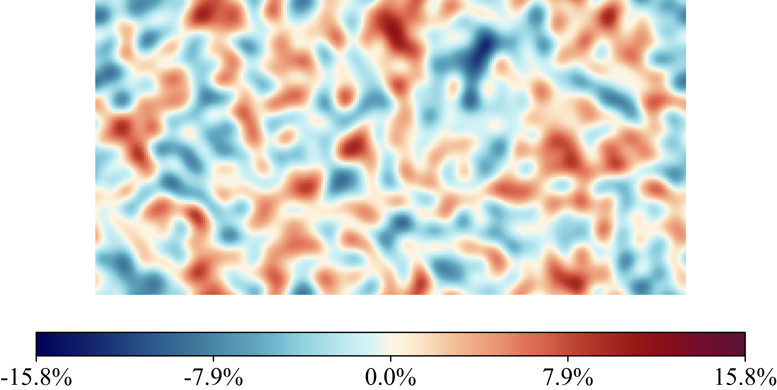
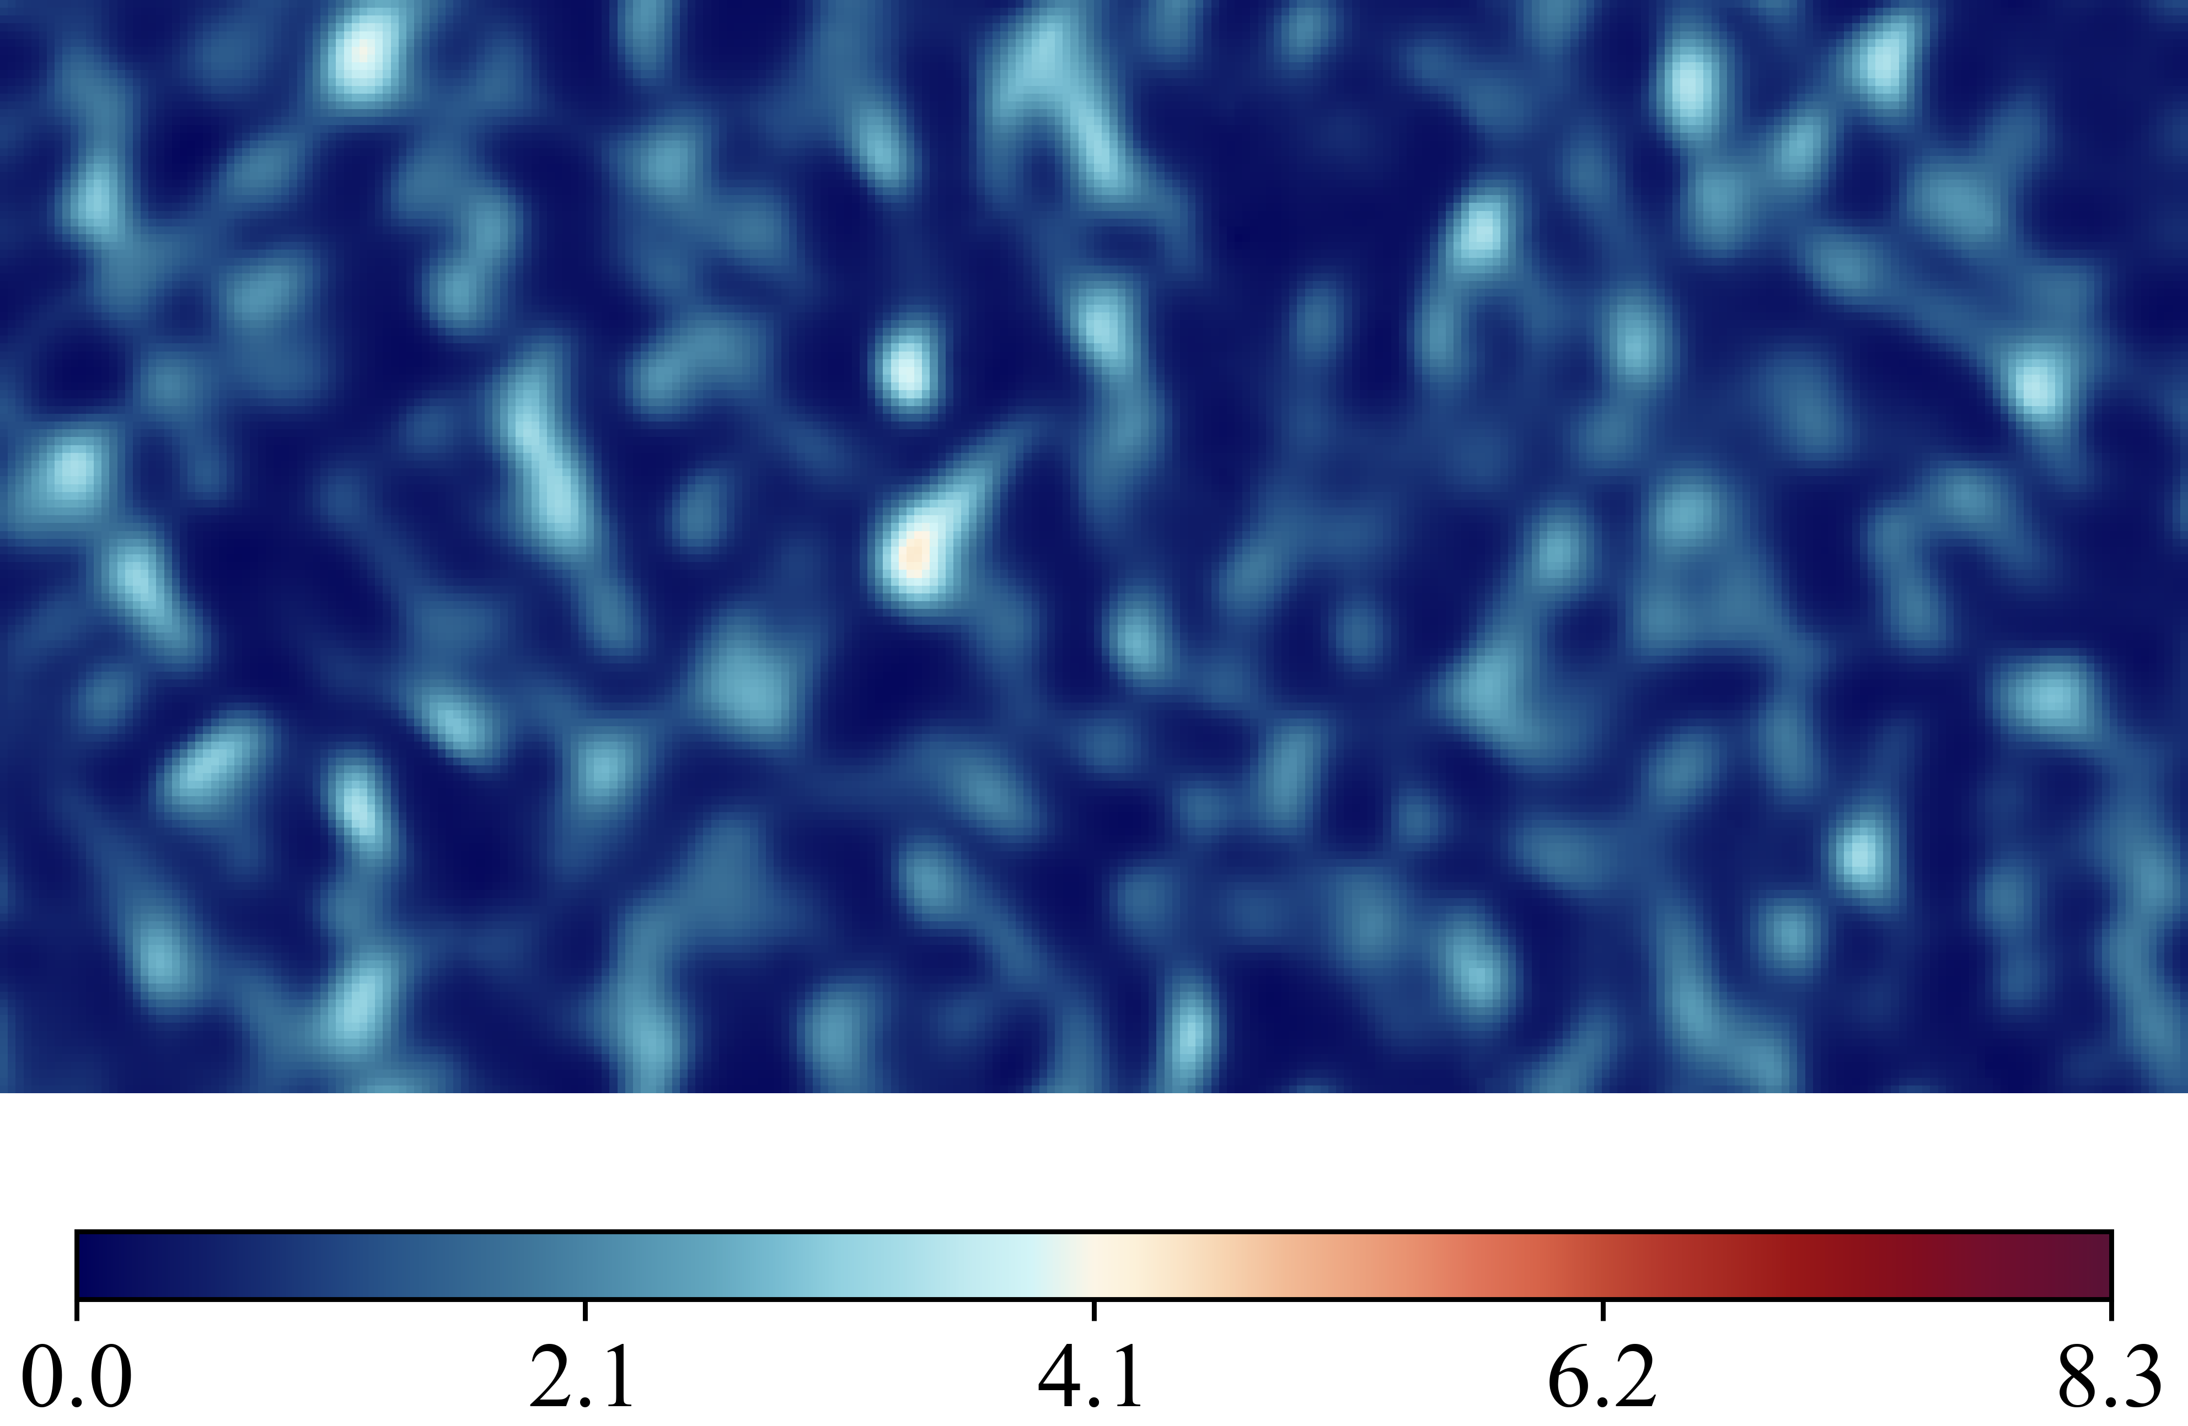
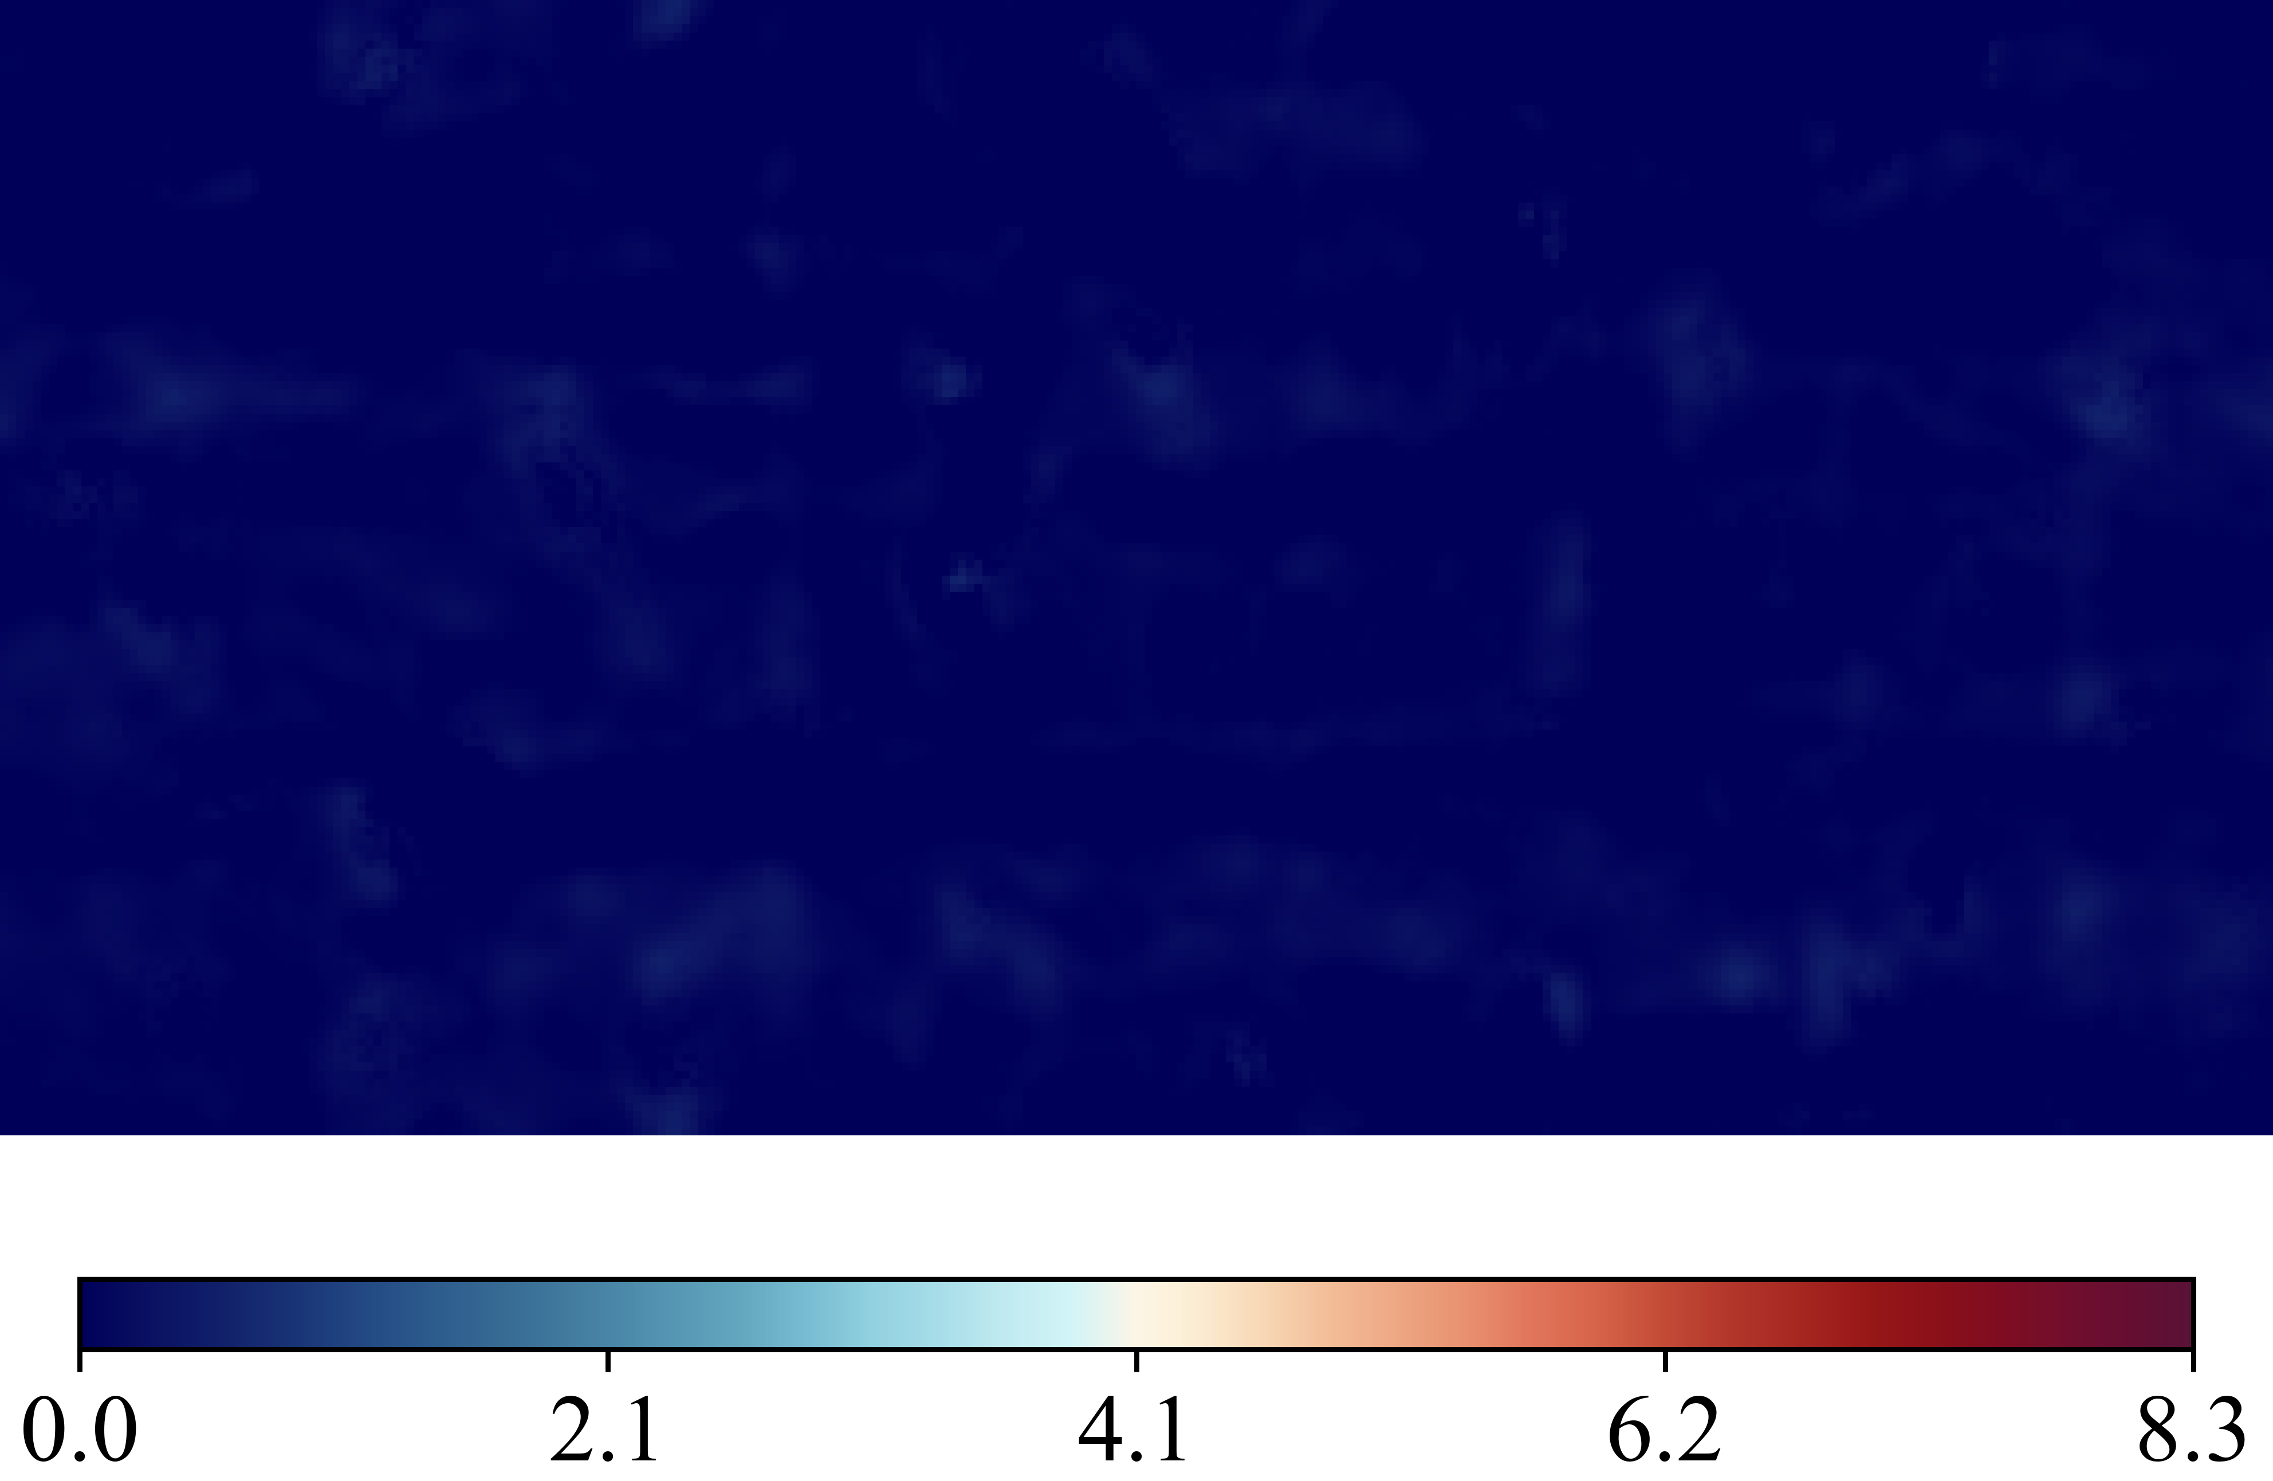
Case 20250516_103126_rnd12_K03_l1_Nu_classic_net_alt2_orig_dset_valid_ind_6_Ktrials_0_1
(Nusselt Number)
DNS Labels
Height Map
Predicted (ML)
Errors Difference

Slide 9
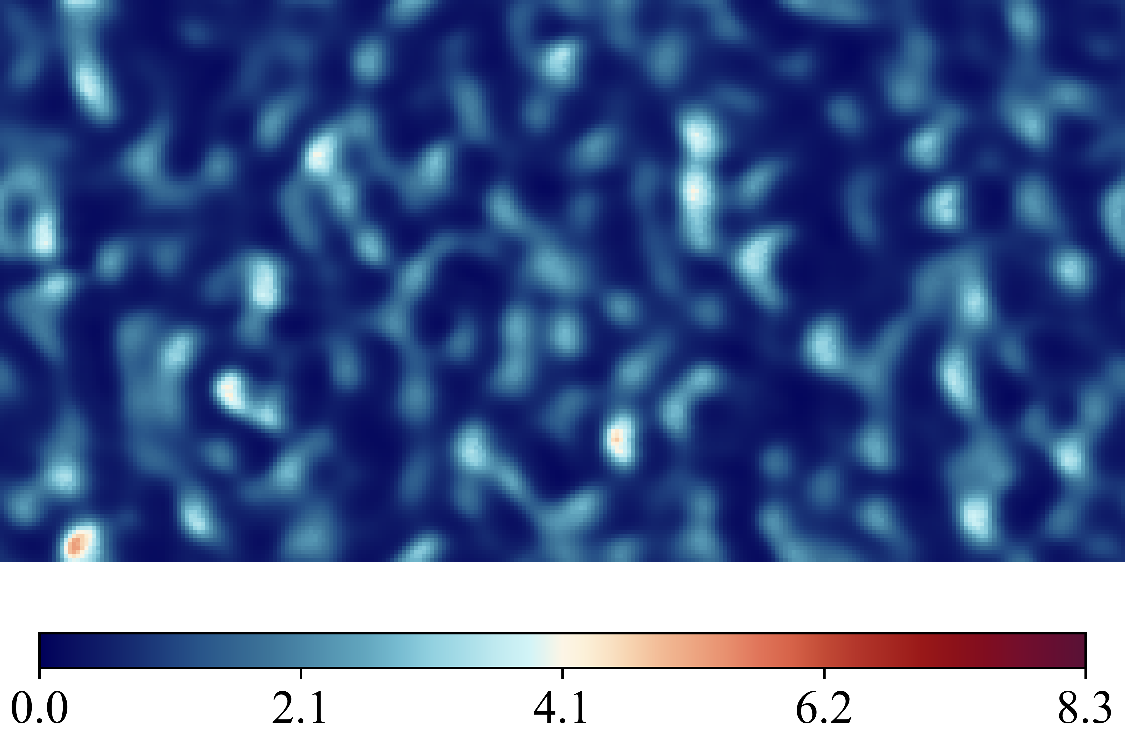
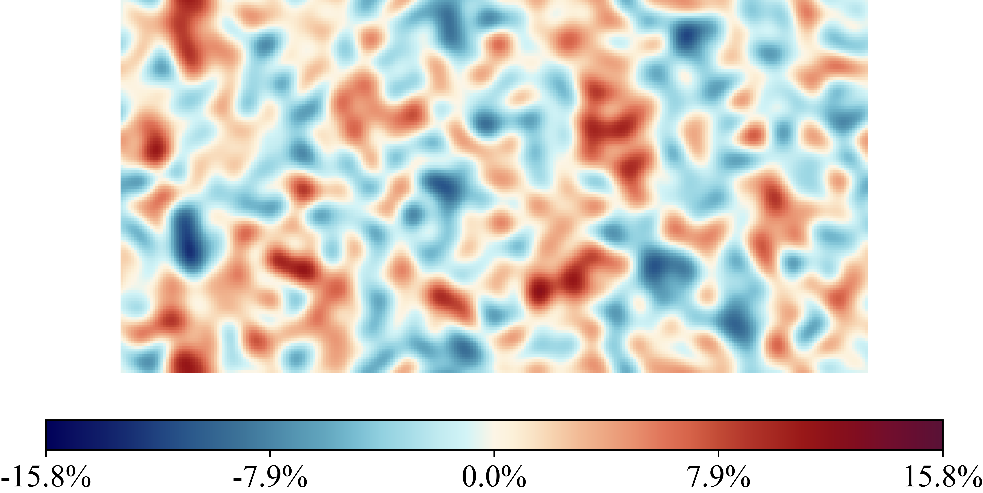
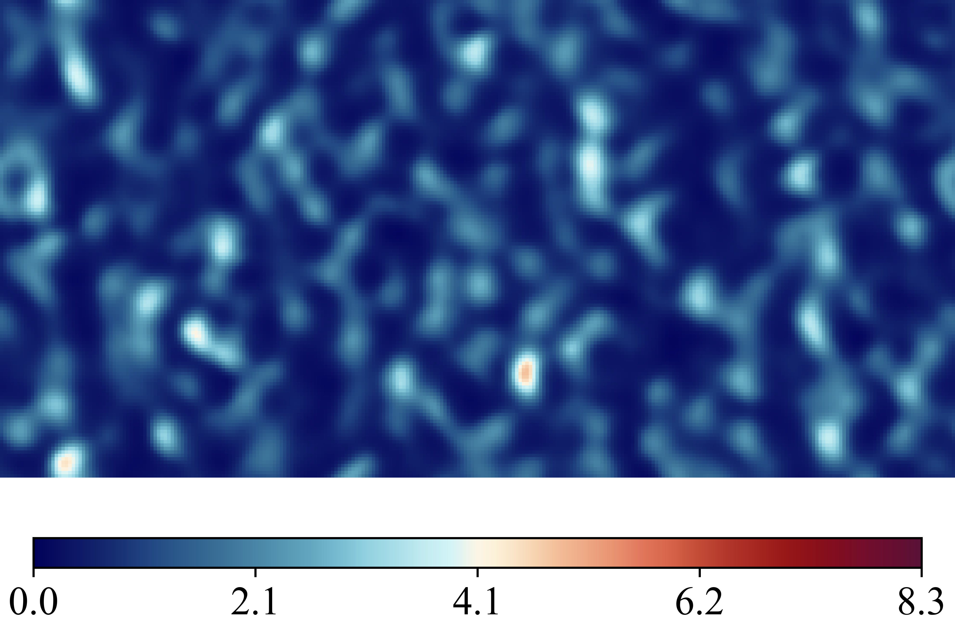
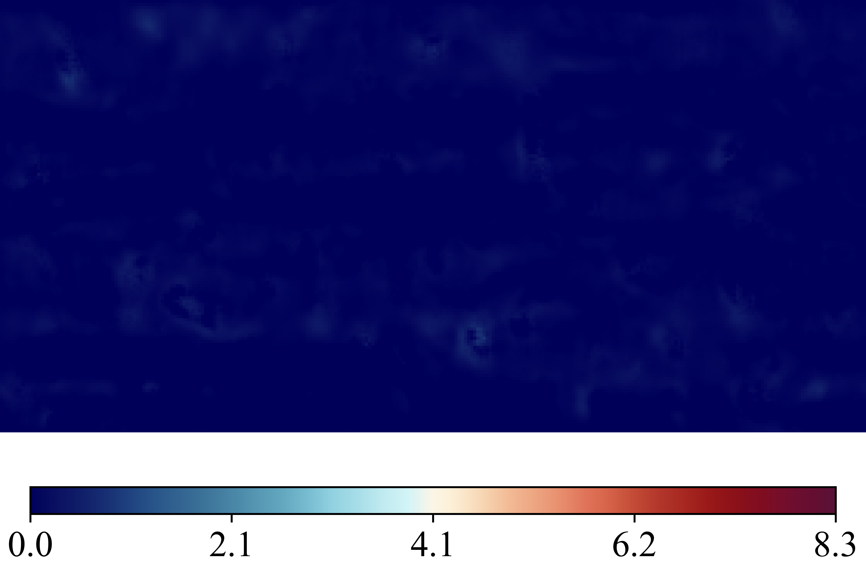
Case 20250516_103241_rnd12_K03_l1_Nu_classic_net_alt2_orig_dset_valid_ind_7_Ktrials_1_2
(Nusselt Number)
DNS Labels
Height Map
Predicted (ML)
Errors Difference

Slide 10
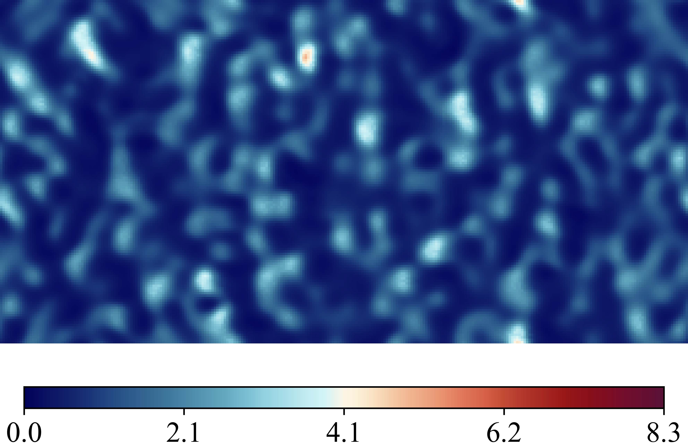
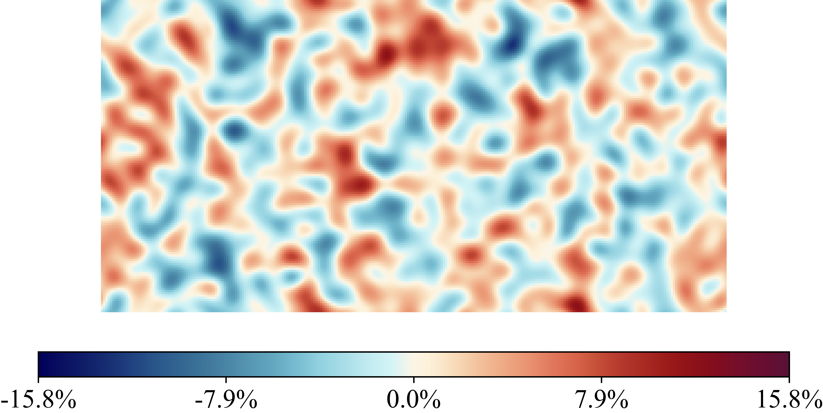
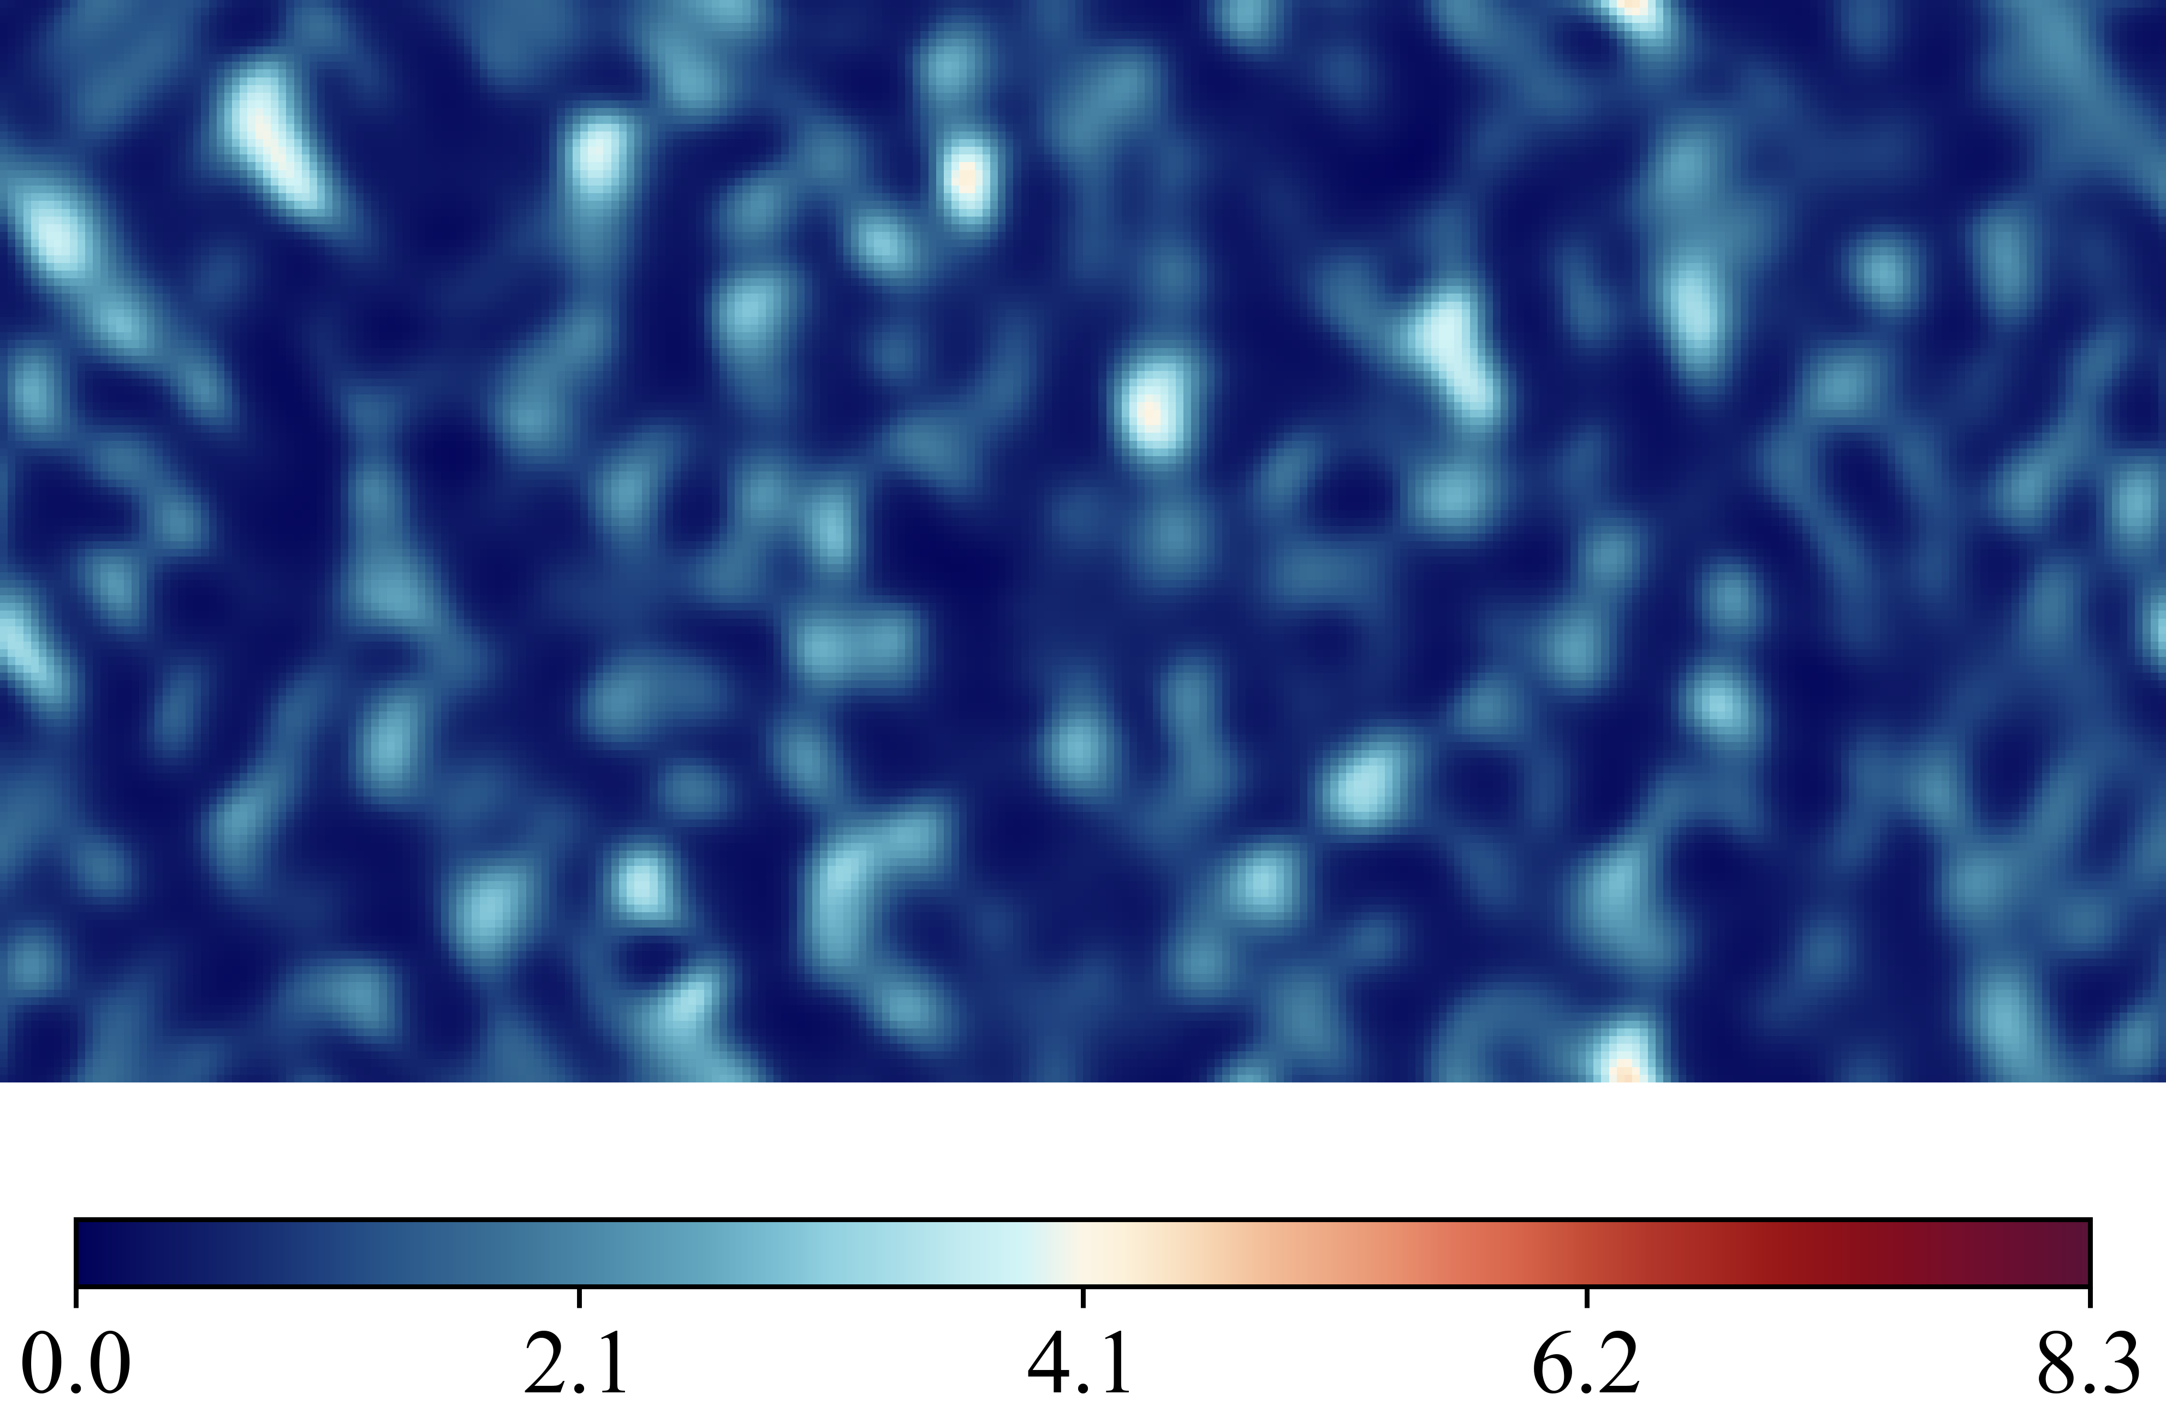
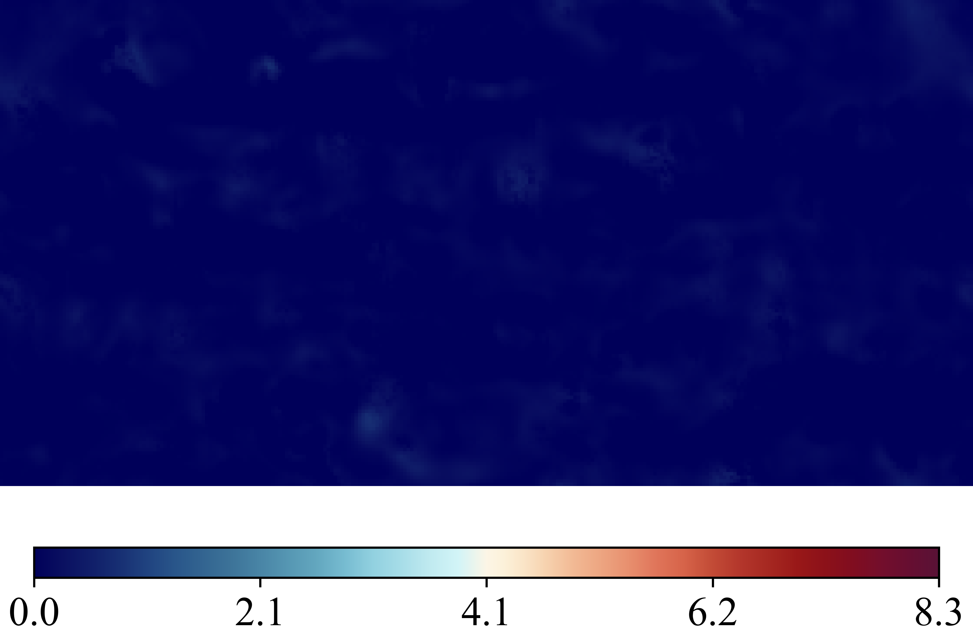
Case 20250516_103356_rnd12_K03_l1_Nu_classic_net_alt2_orig_dset_valid_ind_8_Ktrials_0_2
(Nusselt Number)
DNS Labels
Height Map
Predicted (ML)
Errors Difference

Slide 11
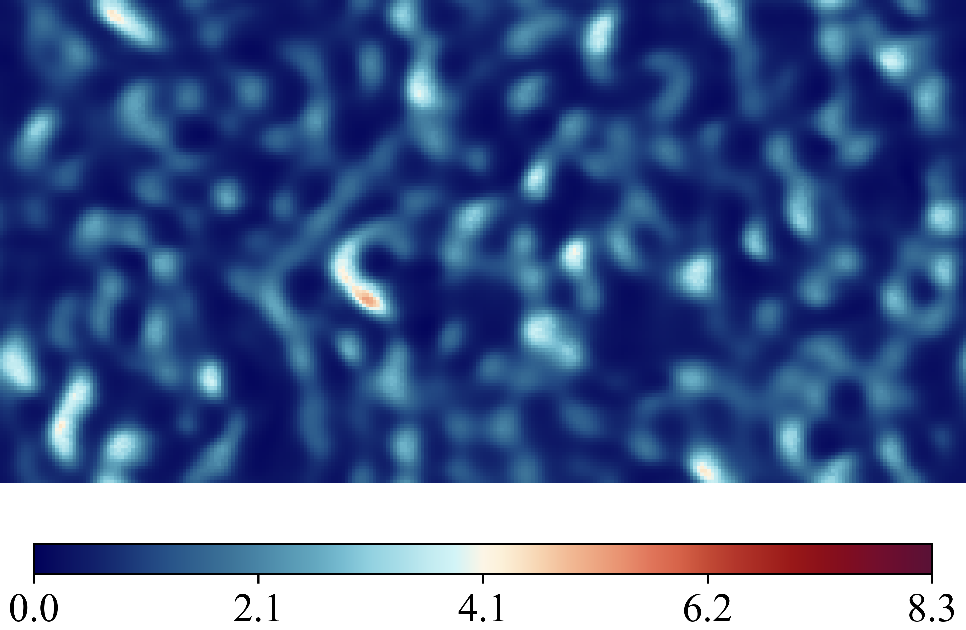
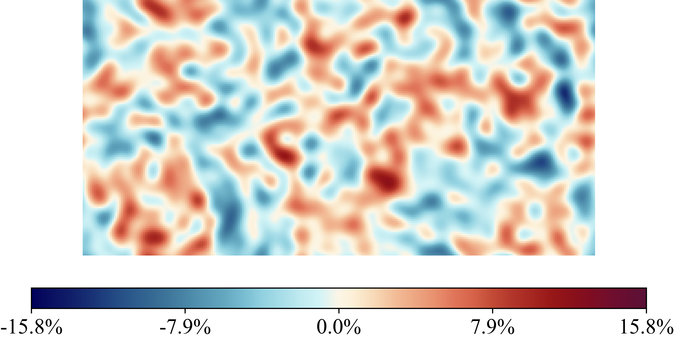
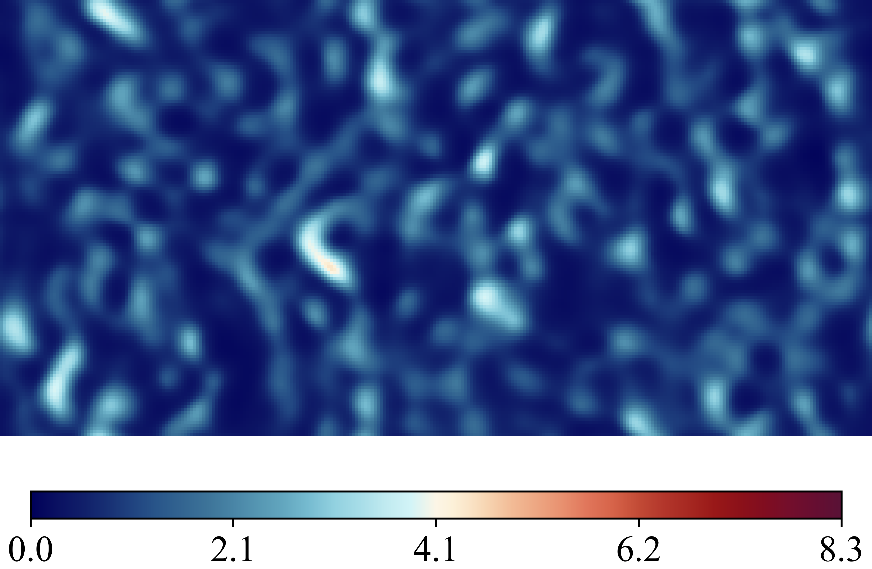
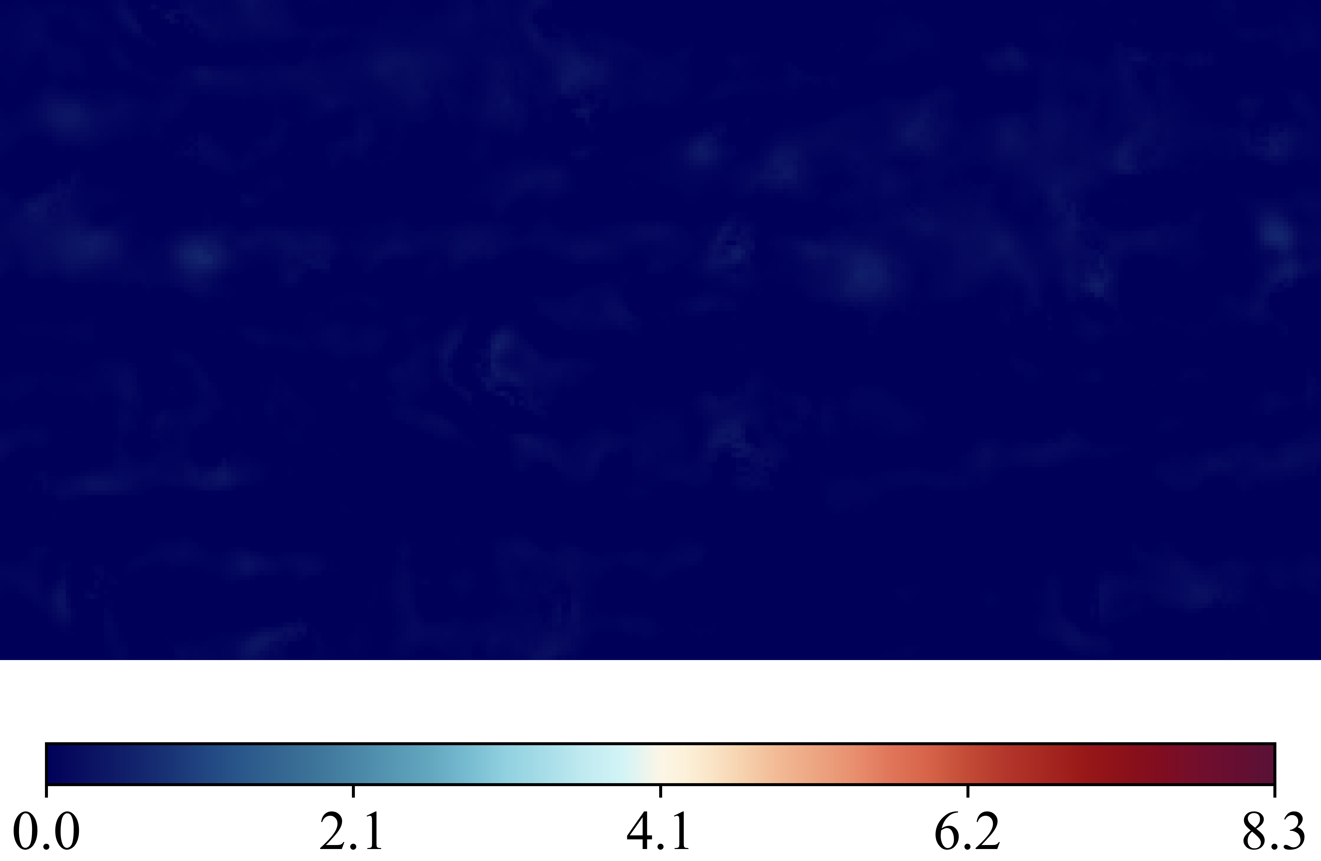
Case 20250516_103513_rnd12_K03_l1_Nu_classic_net_alt2_orig_dset_valid_ind_9_Ktrials_0_1
(Nusselt Number)
DNS Labels
Height Map
Predicted (ML)
Errors Difference

Slide 12
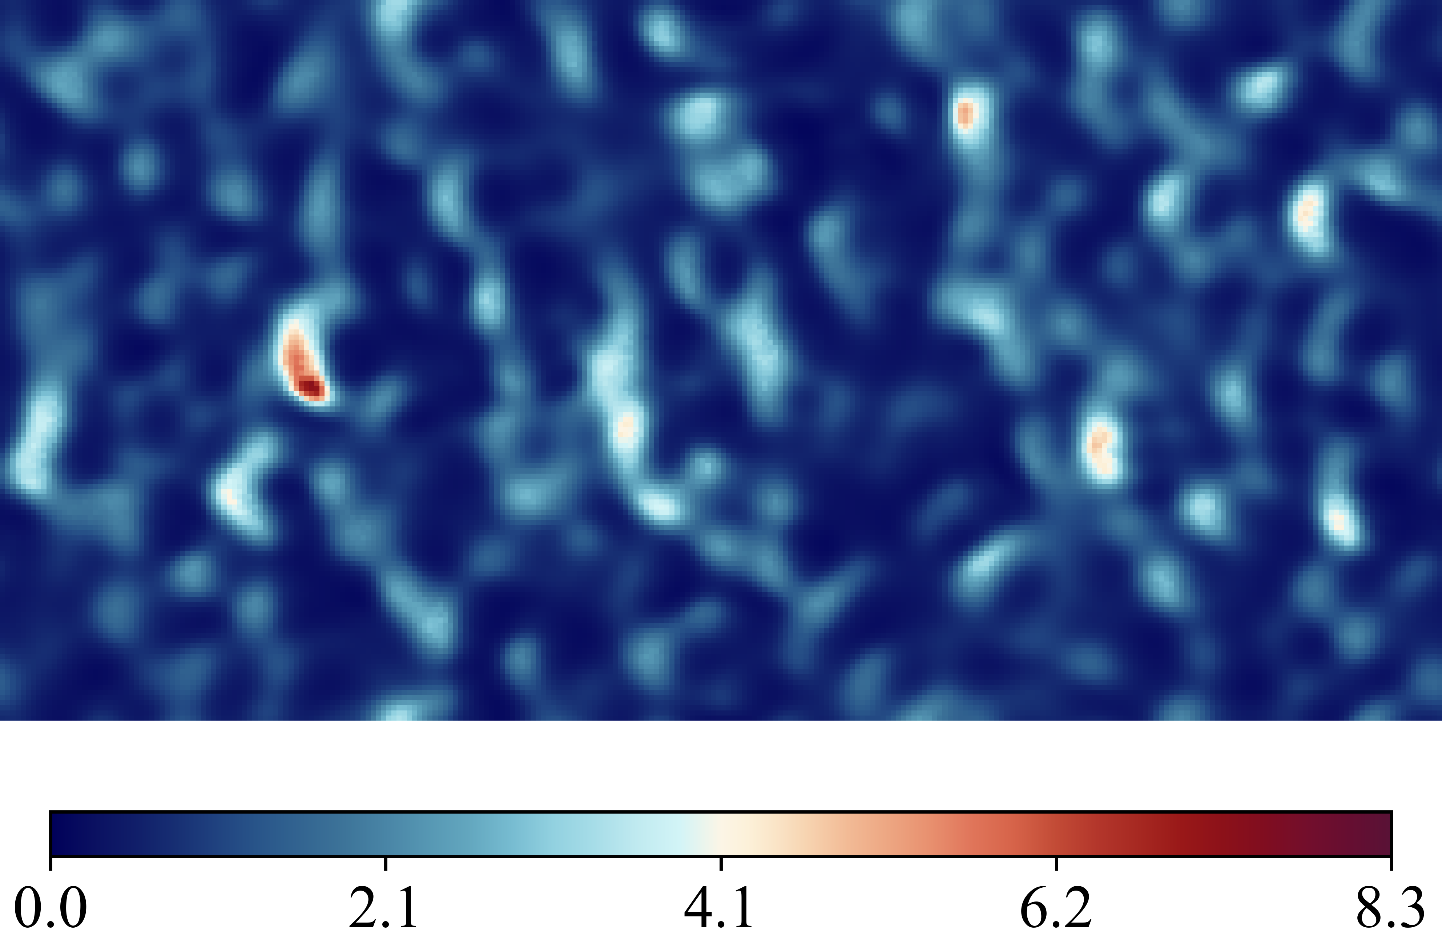
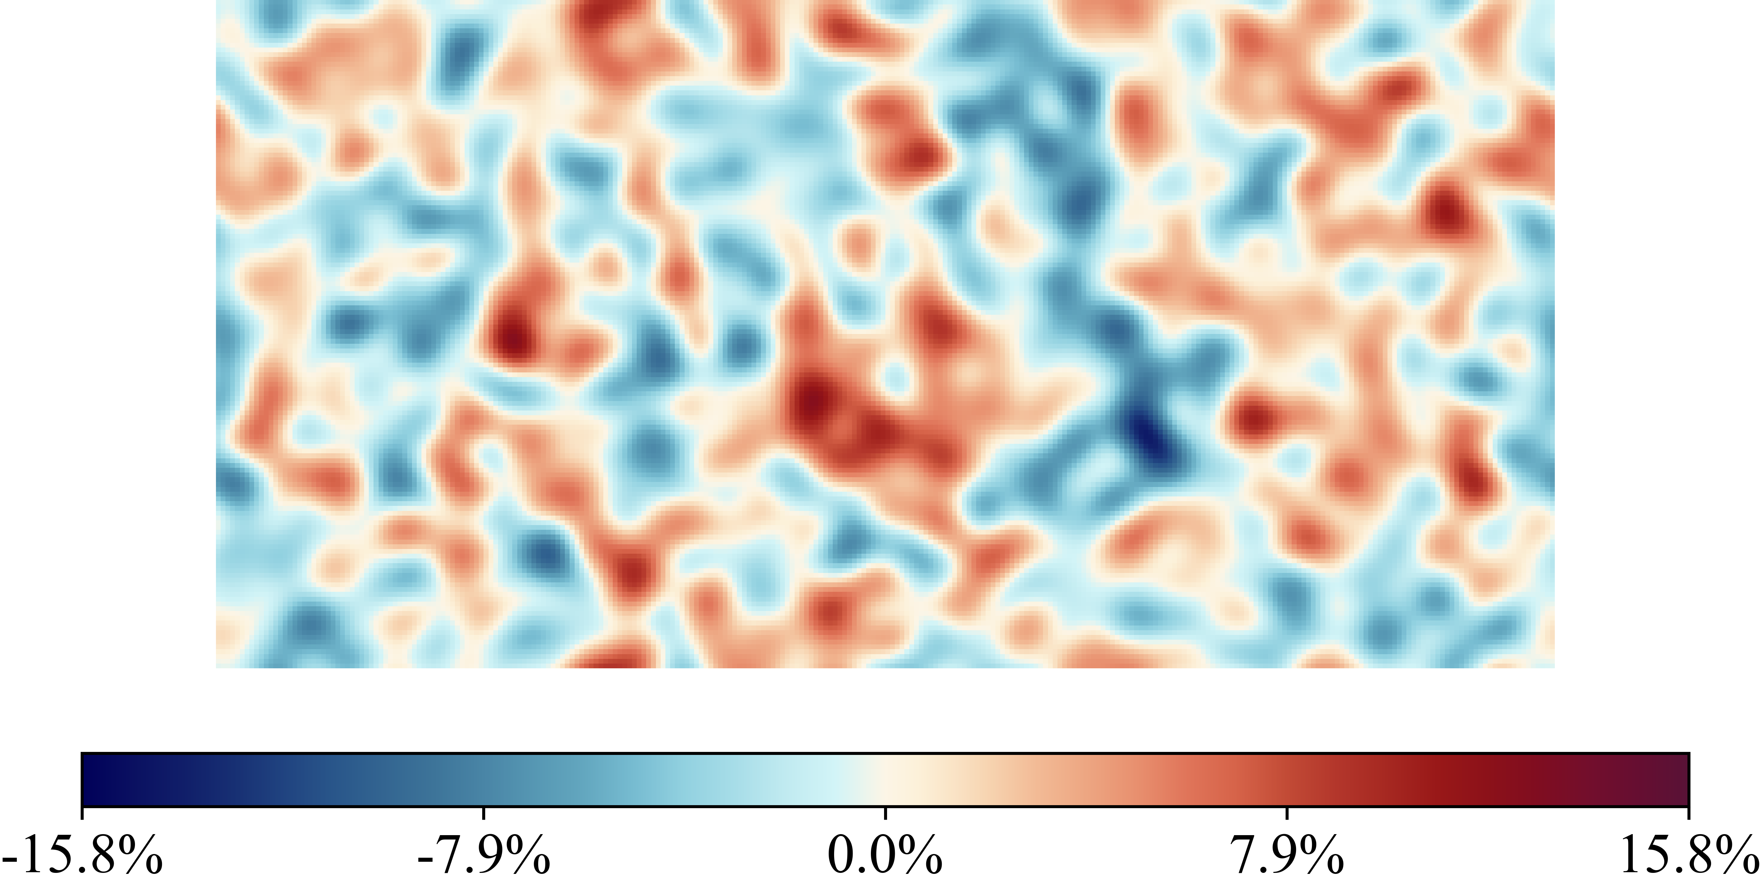
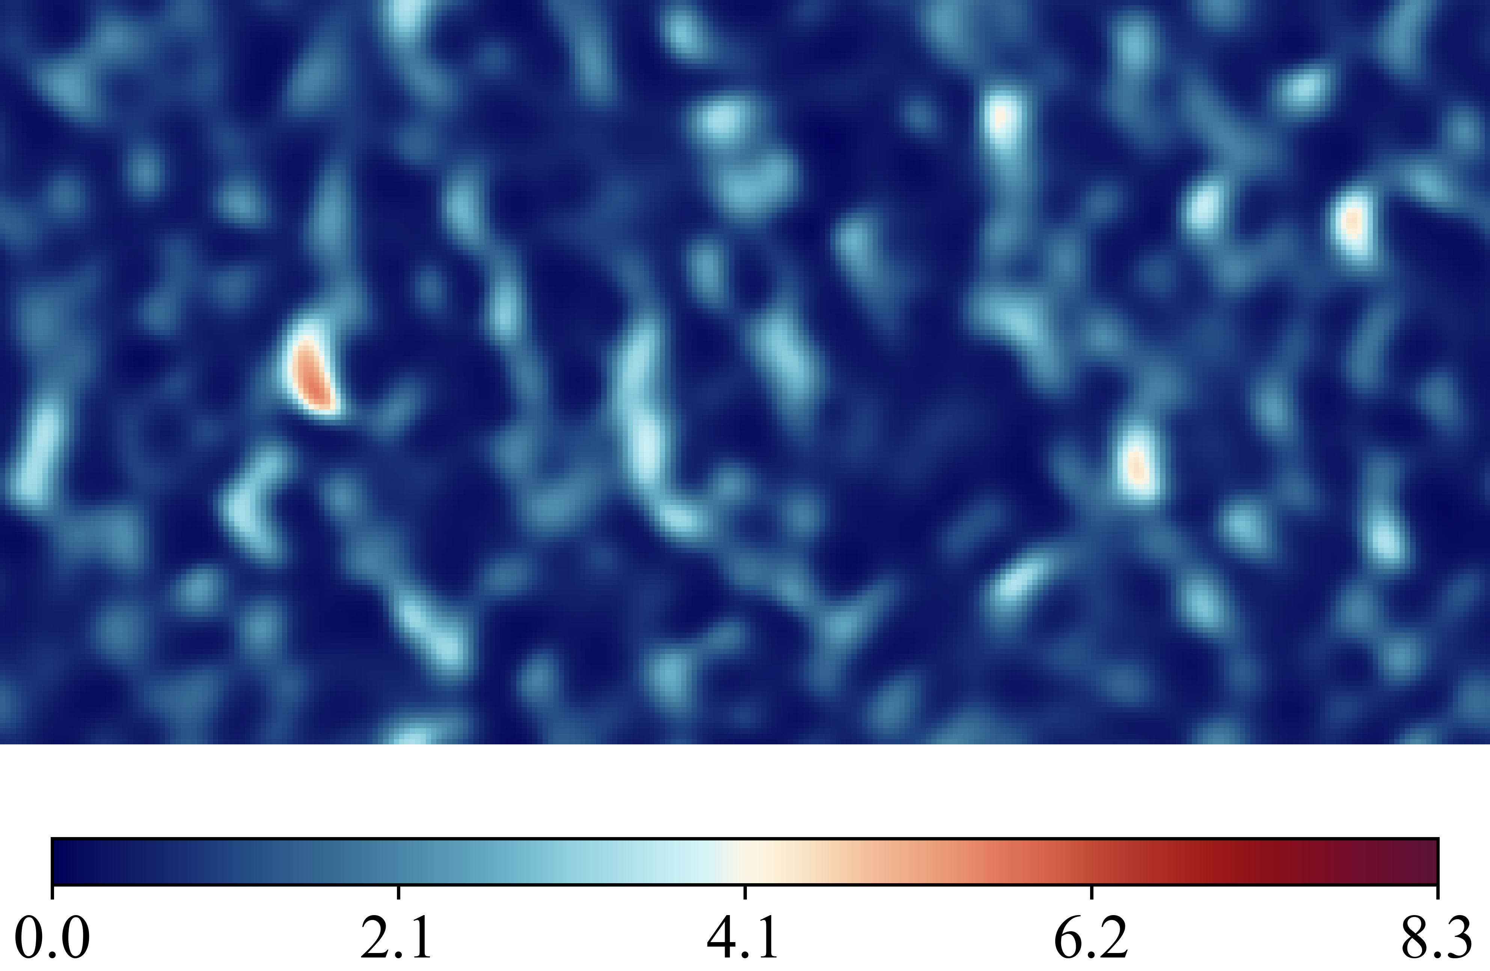
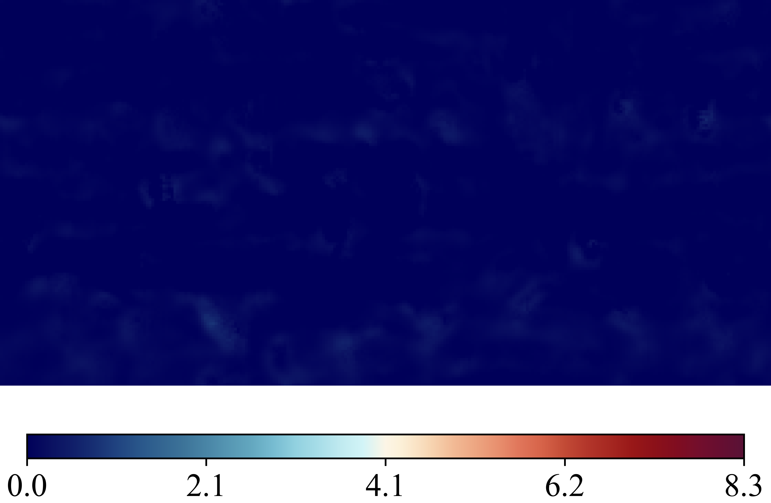
Case 20250516_103631_rnd12_K03_l1_Nu_classic_net_alt2_orig_dset_valid_ind_10_Ktrials_0_2
(Nusselt Number)
DNS Labels
Height Map
Predicted (ML)
Errors Difference

Slide 13
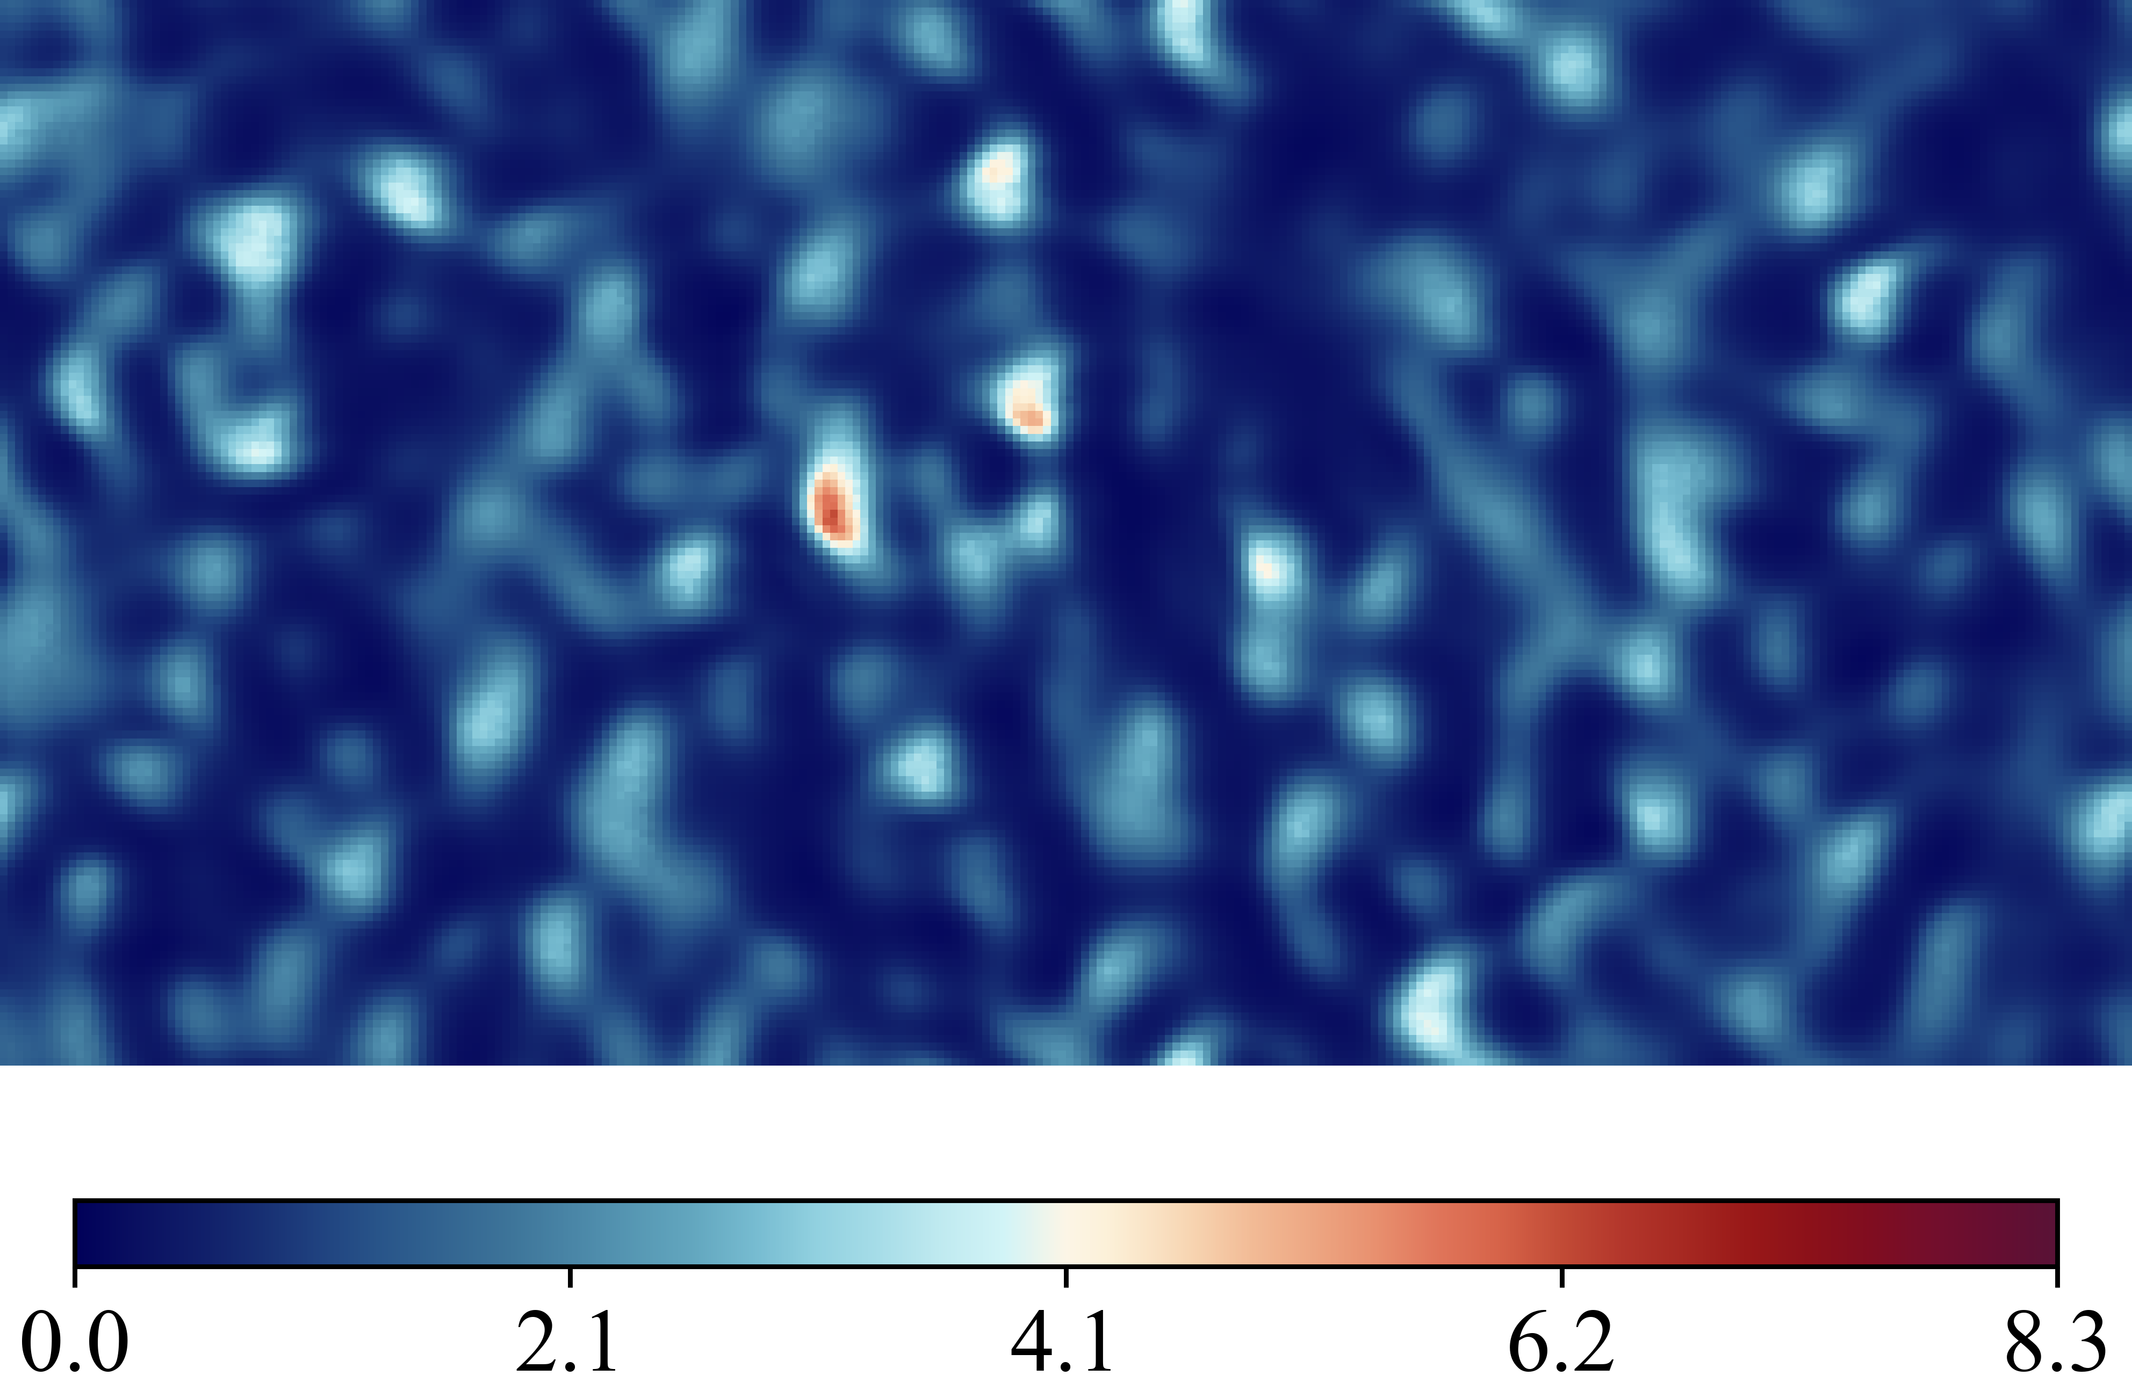
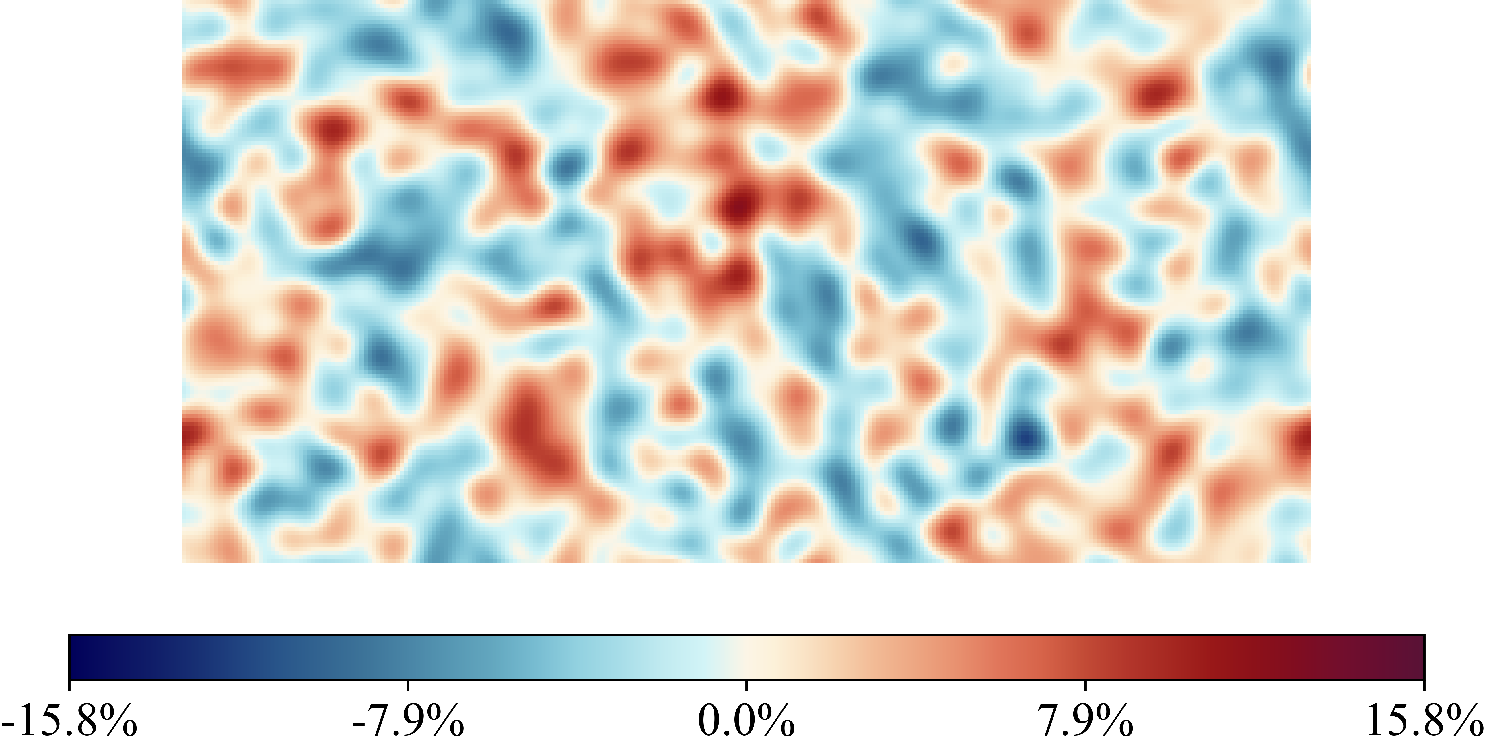
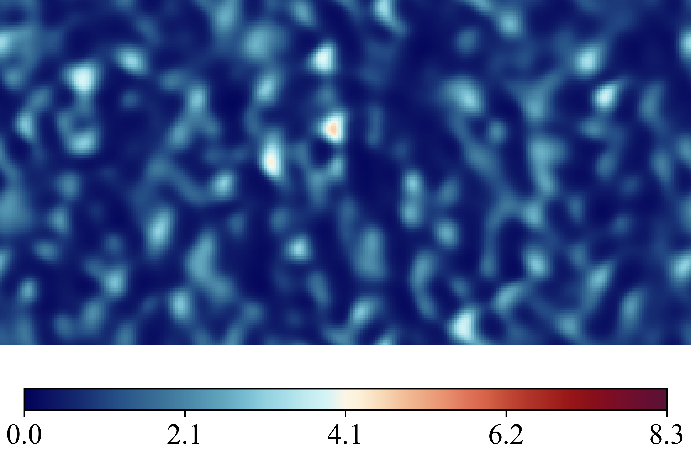
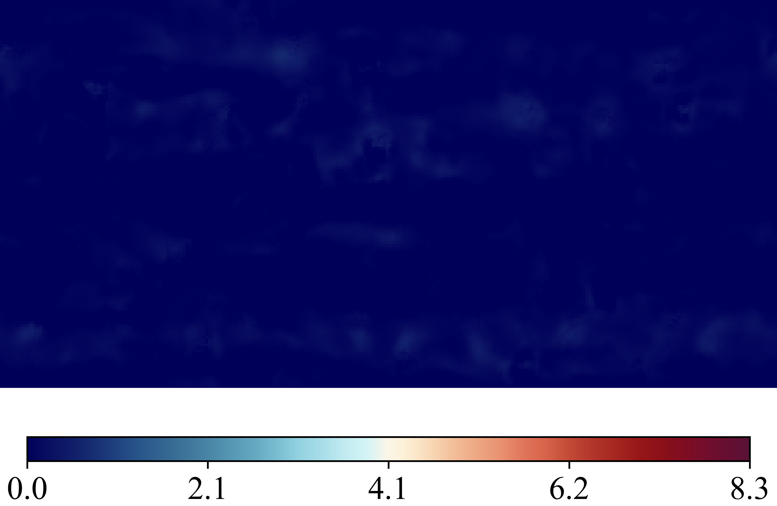
Case 20250516_103747_rnd12_K03_l1_Nu_classic_net_alt2_orig_dset_valid_ind_11_Ktrials_0_1
(Nusselt Number)
DNS Labels
Height Map
Predicted (ML)
Errors Difference

Slide 14
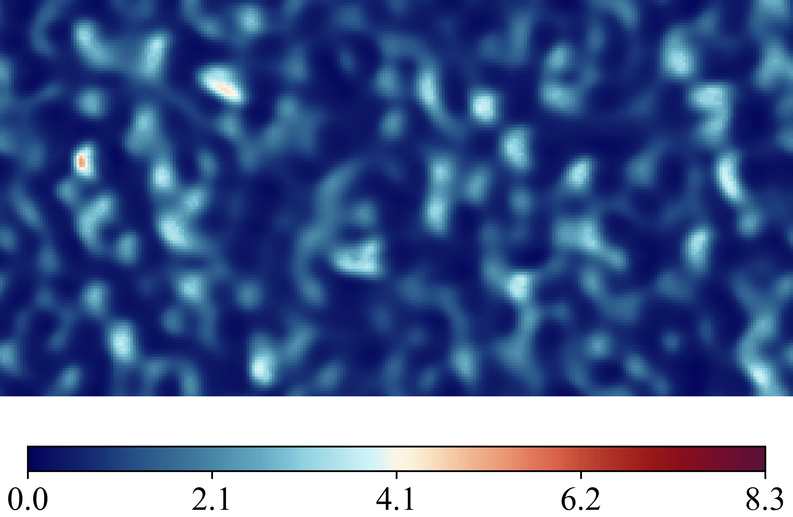
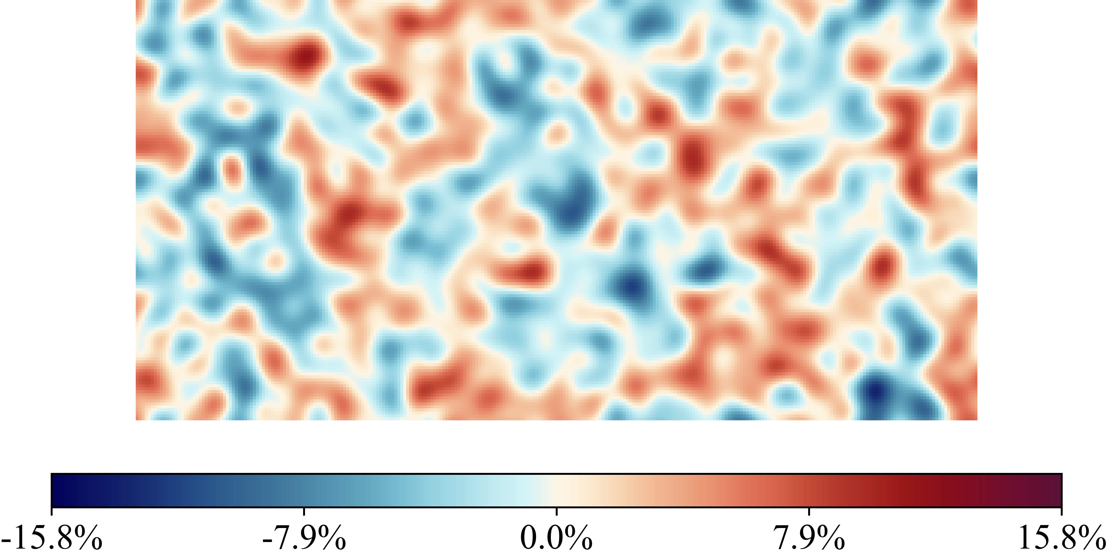
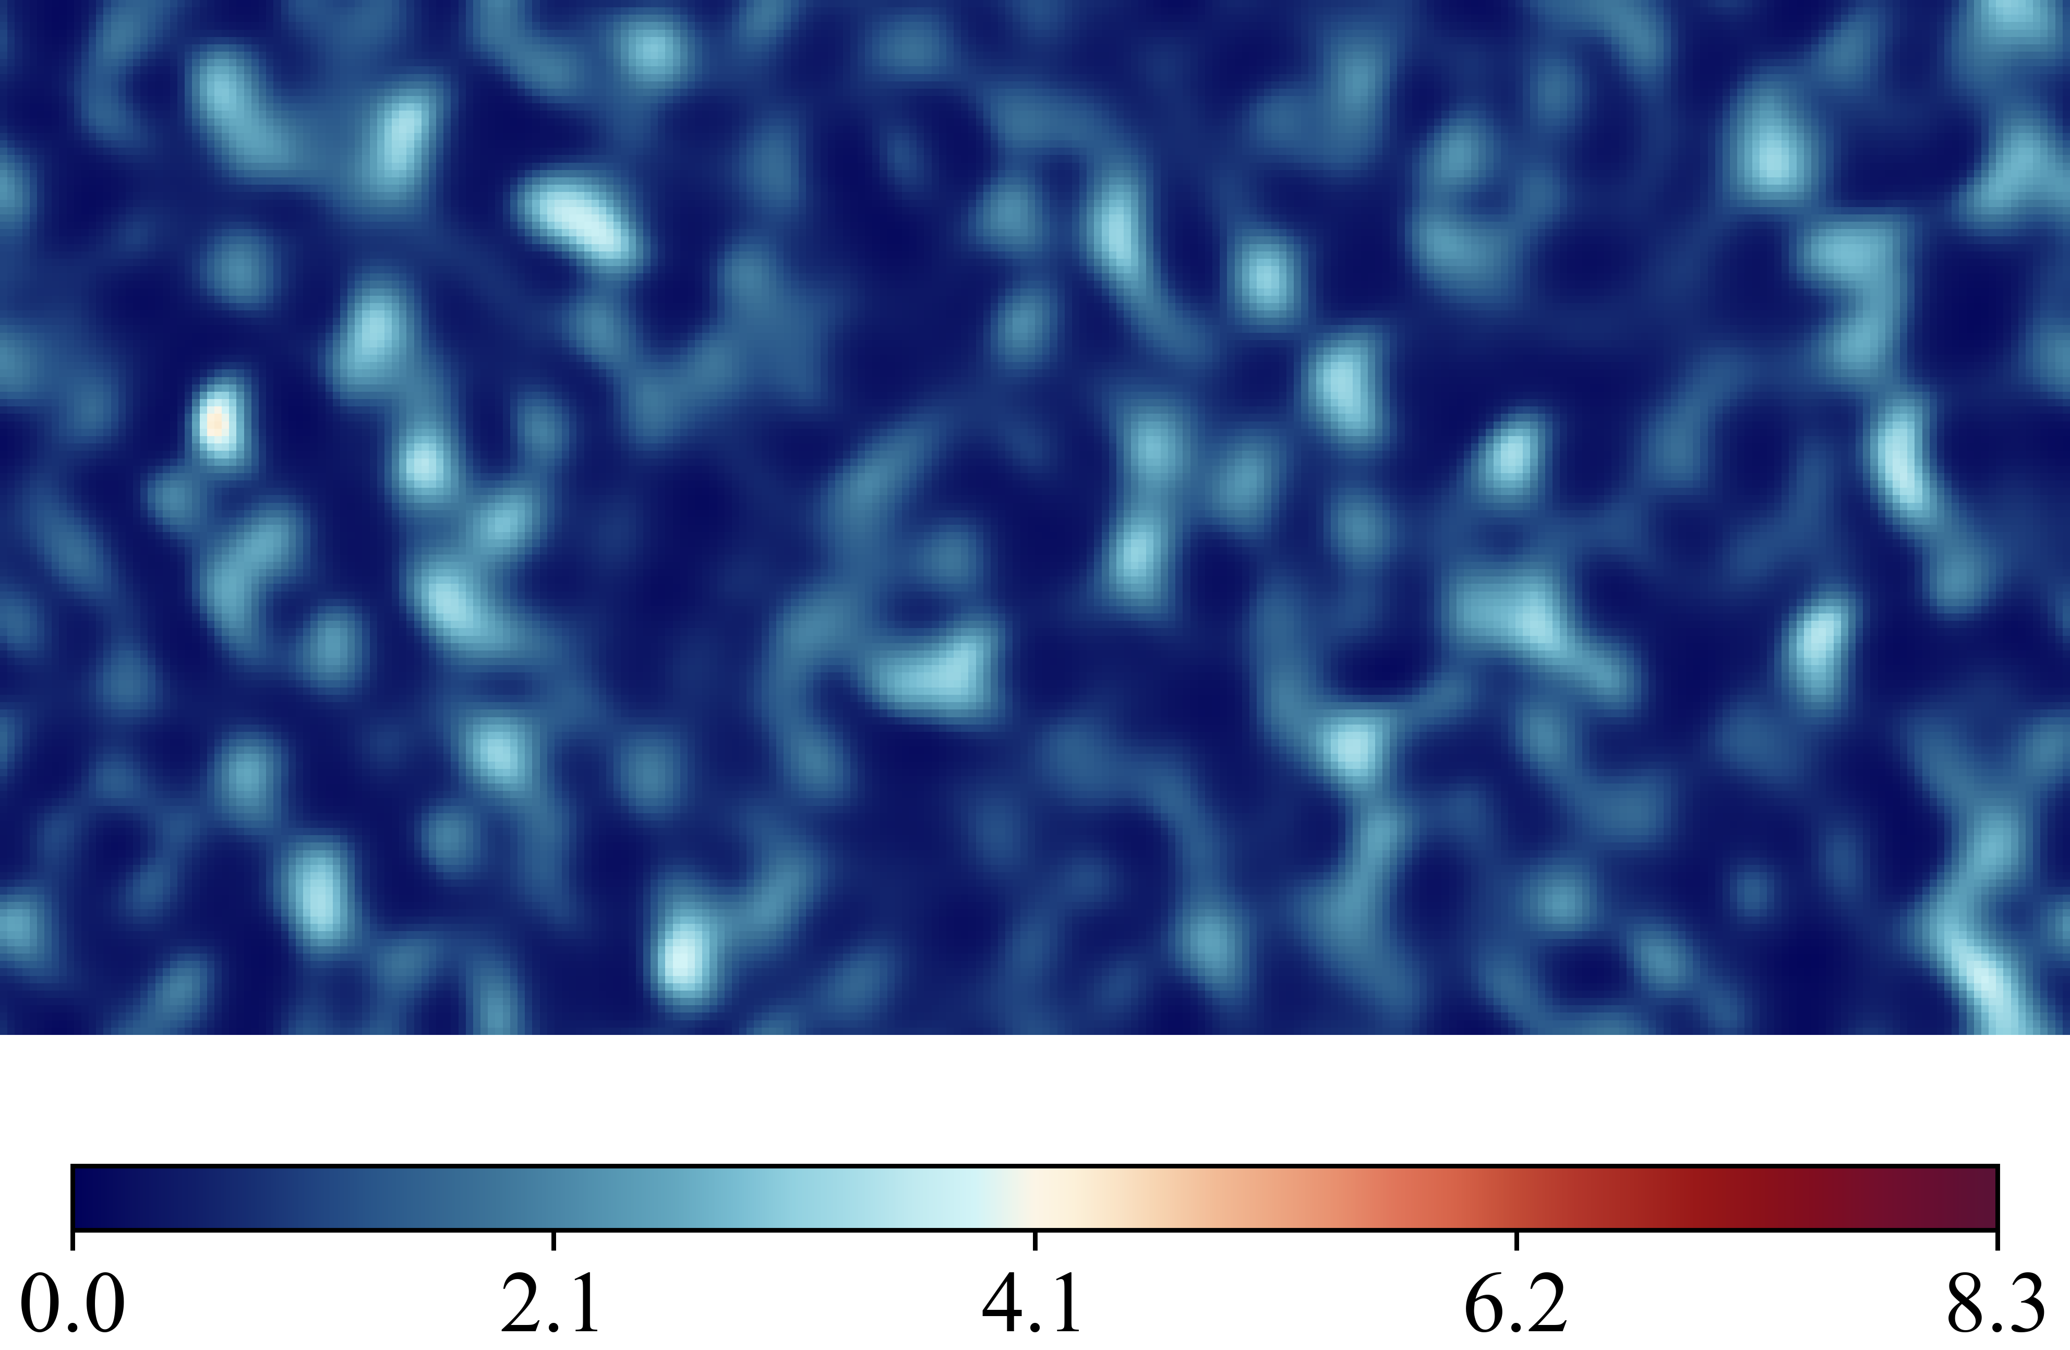

Case 20250516_103902_rnd12_K03_l1_Nu_classic_net_alt2_orig_dset_valid_ind_12_Ktrials_1_2
(Nusselt Number)
DNS Labels
Height Map
Predicted (ML)
Errors Difference

Slide 15




Case 20250516_104017_rnd12_K03_l1_Nu_classic_net_alt2_orig_dset_valid_ind_13_Ktrials_0_2
(Nusselt Number)
DNS Labels
Height Map
Predicted (ML)
Errors Difference

Slide 16




Case 20250516_104132_rnd12_K03_l1_Nu_classic_net_alt2_orig_dset_valid_ind_14_Ktrials_0_2
(Nusselt Number)
DNS Labels
Height Map
Predicted (ML)
Errors Difference

Slide 17




Case 20250516_104247_rnd12_K03_l1_Nu_classic_net_alt2_orig_dset_valid_ind_15_Ktrials_1_2
(Nusselt Number)
DNS Labels
Height Map
Predicted (ML)
Errors Difference

Slide 18




Case 20250516_104403_rnd12_K03_l1_Nu_classic_net_alt2_orig_dset_valid_ind_16_Ktrials_0_2
(Nusselt Number)
DNS Labels
Height Map
Predicted (ML)
Errors Difference

Slide 19




Case 20250516_104518_rnd12_K03_l1_Nu_classic_net_alt2_orig_dset_valid_ind_17_Ktrials_0_2
(Nusselt Number)
DNS Labels
Height Map
Predicted (ML)
Errors Difference

Slide 20




Case 20250516_104633_rnd12_K03_l1_Nu_classic_net_alt2_orig_dset_valid_ind_18_Ktrials_0_1
(Nusselt Number)
DNS Labels
Height Map
Predicted (ML)
Errors Difference

Slide 21




Case 20250516_104746_rnd12_K03_l1_Nu_classic_net_alt2_orig_dset_valid_ind_19_Ktrials_0_1
(Nusselt Number)
DNS Labels
Height Map
Predicted (ML)
Errors Difference

Slide 22




Case 20250516_095909_rnd12_K03_l1_Nu_classic_net_alt2_orig_dset_test_ind_20_Ktrials_1_2
(Nusselt Number)
DNS Labels
Height Map
Predicted (ML)
Errors Difference

Slide 23




Case 20250516_100026_rnd12_K03_l1_Nu_classic_net_alt2_orig_dset_test_ind_21_Ktrials_1_2
(Nusselt Number)
DNS Labels
Height Map
Predicted (ML)
Errors Difference

Slide 24




Case 20250516_100141_rnd12_K03_l1_Nu_classic_net_alt2_orig_dset_test_ind_22_Ktrials_0_2
(Nusselt Number)
DNS Labels
Height Map
Predicted (ML)
Errors Difference

Slide 25




Case 20250516_100257_rnd12_K03_l1_Nu_classic_net_alt2_orig_dset_test_ind_23_Ktrials_0_2
(Nusselt Number)
DNS Labels
Height Map
Predicted (ML)
Errors Difference

Slide 26




Case 20250516_100414_rnd12_K03_l1_Nu_classic_net_alt2_orig_dset_test_ind_24_Ktrials_0_2
(Nusselt Number)
DNS Labels
Height Map
Predicted (ML)
Errors Difference

Slide 27




Case 20250516_100529_rnd12_K03_l1_Nu_classic_net_alt2_orig_dset_test_ind_25_Ktrials_0_1
(Nusselt Number)
DNS Labels
Height Map
Predicted (ML)
Errors Difference

Slide 28




Case 20250516_100644_rnd12_K03_l1_Nu_classic_net_alt2_orig_dset_test_ind_26_Ktrials_1_2
(Nusselt Number)
DNS Labels
Height Map
Predicted (ML)
Errors Difference

Slide 29




Case 20250516_100759_rnd12_K03_l1_Nu_classic_net_alt2_orig_dset_test_ind_27_Ktrials_1_2
(Nusselt Number)
DNS Labels
Height Map
Predicted (ML)
Errors Difference

Slide 30




Case 20250516_100915_rnd12_K03_l1_Nu_classic_net_alt2_orig_dset_test_ind_28_Ktrials_0_1
(Nusselt Number)
DNS Labels
Height Map
Predicted (ML)
Errors Difference

Slide 31




Case 20250516_101030_rnd12_K03_l1_Nu_classic_net_alt2_orig_dset_test_ind_29_Ktrials_1_2
(Nusselt Number)
DNS Labels
Height Map
Predicted (ML)
Errors Difference

Slide 32




Case 20250516_101145_rnd12_K03_l1_Nu_classic_net_alt2_orig_dset_test_ind_30_Ktrials_0_1
(Nusselt Number)
DNS Labels
Height Map
Predicted (ML)
Errors Difference

Slide 33




Case 20250516_101300_rnd12_K03_l1_Nu_classic_net_alt2_orig_dset_test_ind_31_Ktrials_0_1
(Nusselt Number)
DNS Labels
Height Map
Predicted (ML)
Errors Difference

Slide 34




Case 20250516_101415_rnd12_K03_l1_Nu_classic_net_alt2_orig_dset_test_ind_32_Ktrials_0_1
(Nusselt Number)
DNS Labels
Height Map
Predicted (ML)
Errors Difference

Slide 35




Case 20250516_101530_rnd12_K03_l1_Nu_classic_net_alt2_orig_dset_test_ind_33_Ktrials_0_2
(Nusselt Number)
DNS Labels
Height Map
Predicted (ML)
Errors Difference

Slide 36




Case 20250516_101646_rnd12_K03_l1_Nu_classic_net_alt2_orig_dset_test_ind_34_Ktrials_1_2
(Nusselt Number)
DNS Labels
Height Map
Predicted (ML)
Errors Difference

Slide 37




Case 20250516_101801_rnd12_K03_l1_Nu_classic_net_alt2_orig_dset_test_ind_35_Ktrials_0_2
(Nusselt Number)
DNS Labels
Height Map
Predicted (ML)
Errors Difference

Slide 38




Case 20250516_101916_rnd12_K03_l1_Nu_classic_net_alt2_orig_dset_test_ind_36_Ktrials_0_1
(Nusselt Number)
DNS Labels
Height Map
Predicted (ML)
Errors Difference

Slide 39




Case 20250516_102033_rnd12_K03_l1_Nu_classic_net_alt2_orig_dset_test_ind_37_Ktrials_0_2
(Nusselt Number)
DNS Labels
Height Map
Predicted (ML)
Errors Difference

Slide 40




Case 20250516_102148_rnd12_K03_l1_Nu_classic_net_alt2_orig_dset_test_ind_38_Ktrials_1_2
(Nusselt Number)
DNS Labels
Height Map
Predicted (ML)
Errors Difference

Slide 41




Case 20250516_102303_rnd12_K03_l1_Nu_classic_net_alt2_orig_dset_test_ind_39_Ktrials_0_2
(Nusselt Number)
DNS Labels
Height Map
Predicted (ML)
Errors Difference

